Slide 1
Analysis of Propane Gas Fire Experiments and Simulations in Residential Scale Structures
Joseph M. Willi
Master of Science Thesis Defense
May 5, 2017

Slide 2
Overview
Background & Motivation
Experimental Setup
Experimental Procedures
FDS Simulation Description
Results and Discussion
Summary

Slide 3
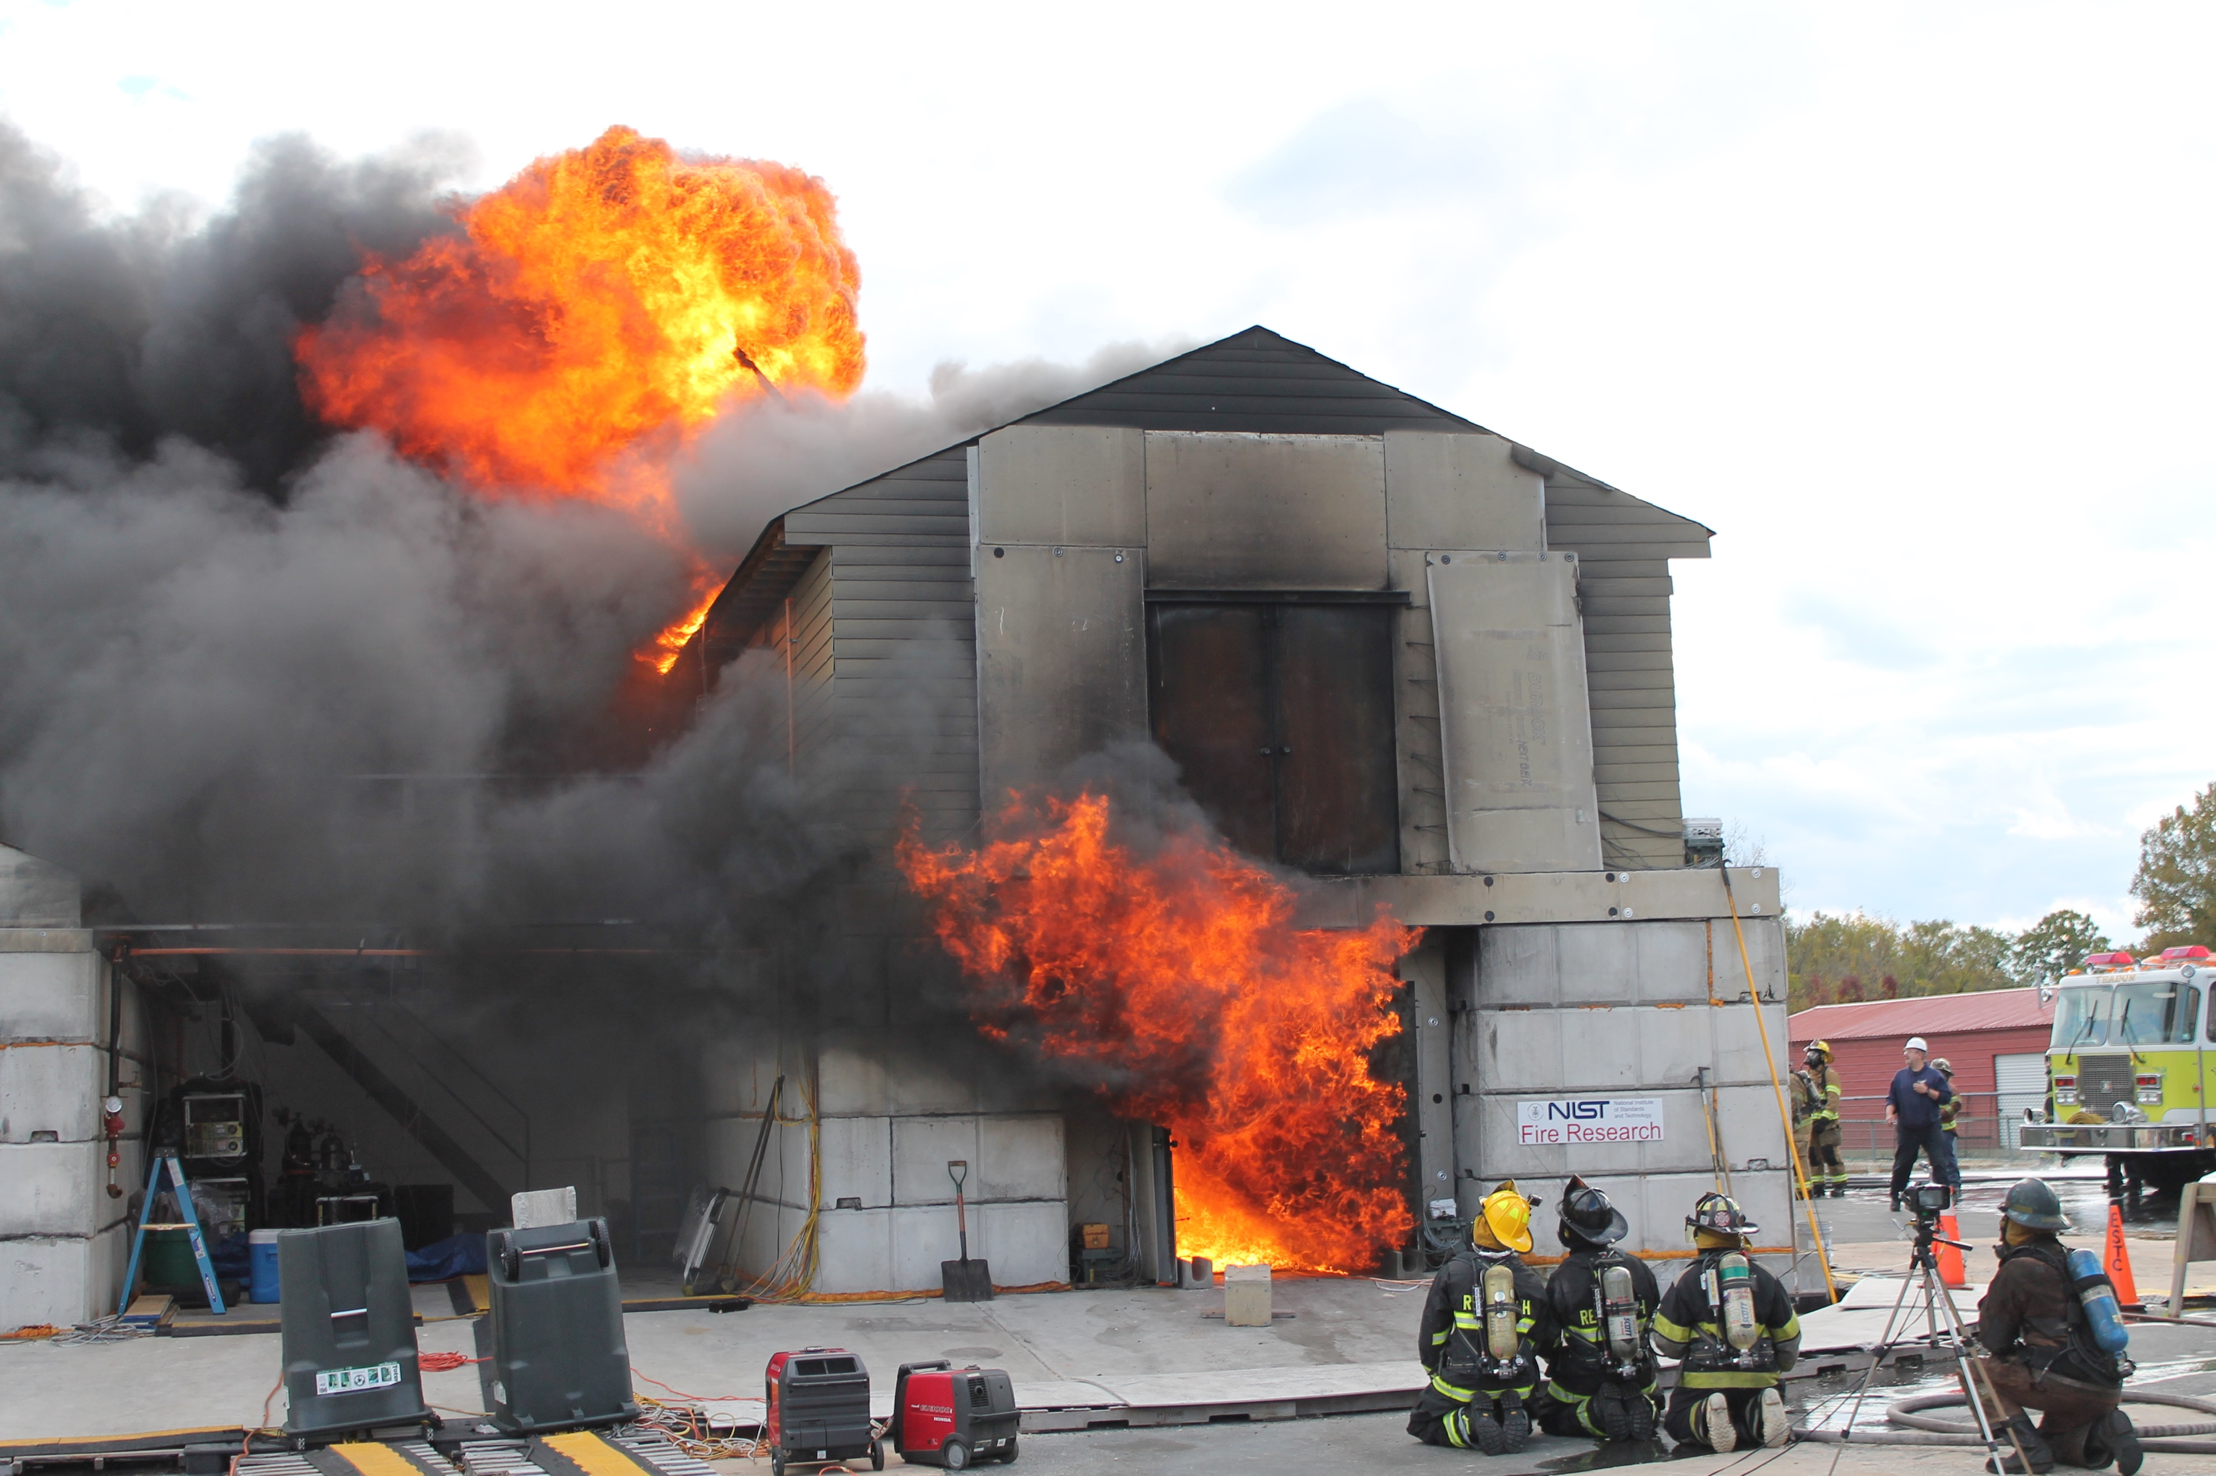
Background
Nine experiments in two structures
Propane gas burners used as fire source
Doors and other vents opened and closed to change ventilation
FDS (version 6.5.3) simulations of each experiment
Notes:
-- Nine experiments part of larger set of experiments, everything from cold flow tests with ppv fans to nine burner tests, to tests with much larger fuel loads, as pictured here
-- Three gas burners with propane as the fuel used for each fire; controlled by high-precision turn valves, total displaced gas volume measured by rotary gas meter
-- Different doors and vents opened during tests to change ventilation within the compartment
-- While gas temperature, velocity, carbon dioxide/O2 concentrations, and heat flux were measured at different points throughout

Slide 4
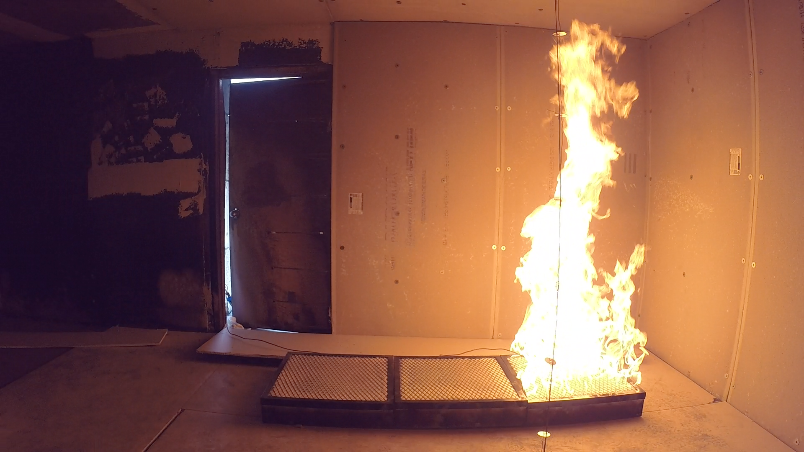
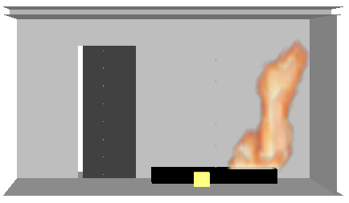
Fire Dynamics Simulator
CFD model of fire-driven fluid flow emphasis on smoke and heat transport from fires
Developed and maintained by NIST
Evaluation of program well-documented by NIST in verification guide^{[1]} and validation guide^{[2]}
Notes:
-- CFD model fire-drive flow; solves a form of navier stokes equations for low-speed (Ma < 0.3), thermally driven flows with emphasis on smoke & heat transport from fires
-- Most popular program used by FPEs to predict fire dynamics and smoke movement for potential fire scenarios
-- Evaluation crucial to determine limitations and acceptable uses of FDS

Slide 5
Verification vs. Validation
Verification checks the math
Validation checks the physics
Compare model results to experimental measurements
52 experiments documented in FDS Validation Guide
Nine burner tests will provide crucial addition to validation database
Notes:
-- Verification: numerical model being solved correctly,
-- Validation: checks that the governing equations are appropriate for specific application being modeled
-- 52 FDS experiments, handful are in residential size structures, none in two-story

Slide 6
Experimental Setup
Notes:
-- Pictures of structures?

Slide 7
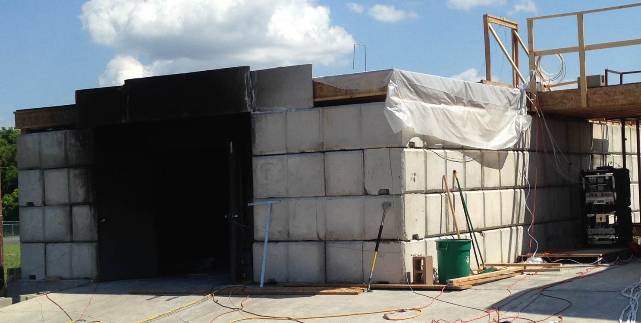
East Structure
Notes:
Highlight 2x2x4 blocks, single story, picture is of the north side

Slide 8
East Structure
Notes:
Entire structure - 24’x40’
Front and back rooms – 20’x12’, middle room 12’x10’
highlight doorways, sealed off room, ceiling height

Slide 9
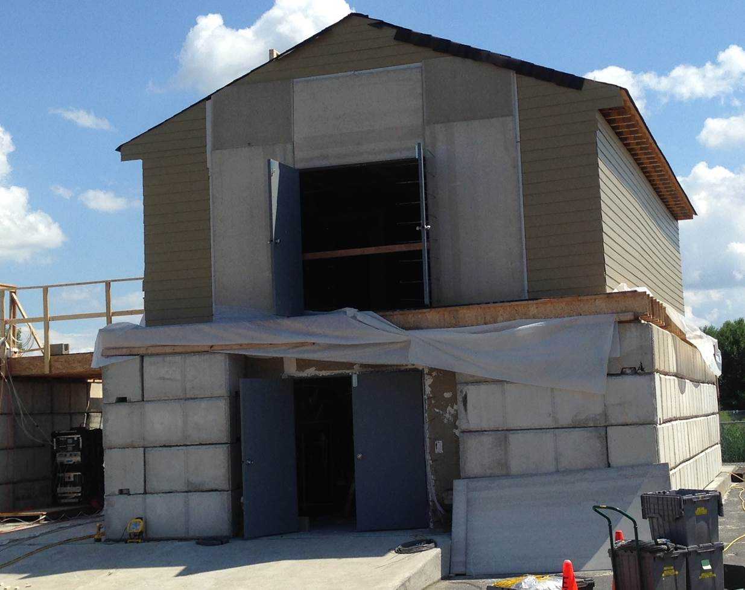
West Structure
Notes:
-- North side of structure; big differentiating factor between this and east structure is second story
-- notice ground floor similar to single-story structure 2x2x4 blocks, double doors on north side
--

Slide 10
West Structure – 1st Floor
Notes:
English units, designed like basement with walk out doors, stairs
7.25” rise/7.5” run

Slide 11
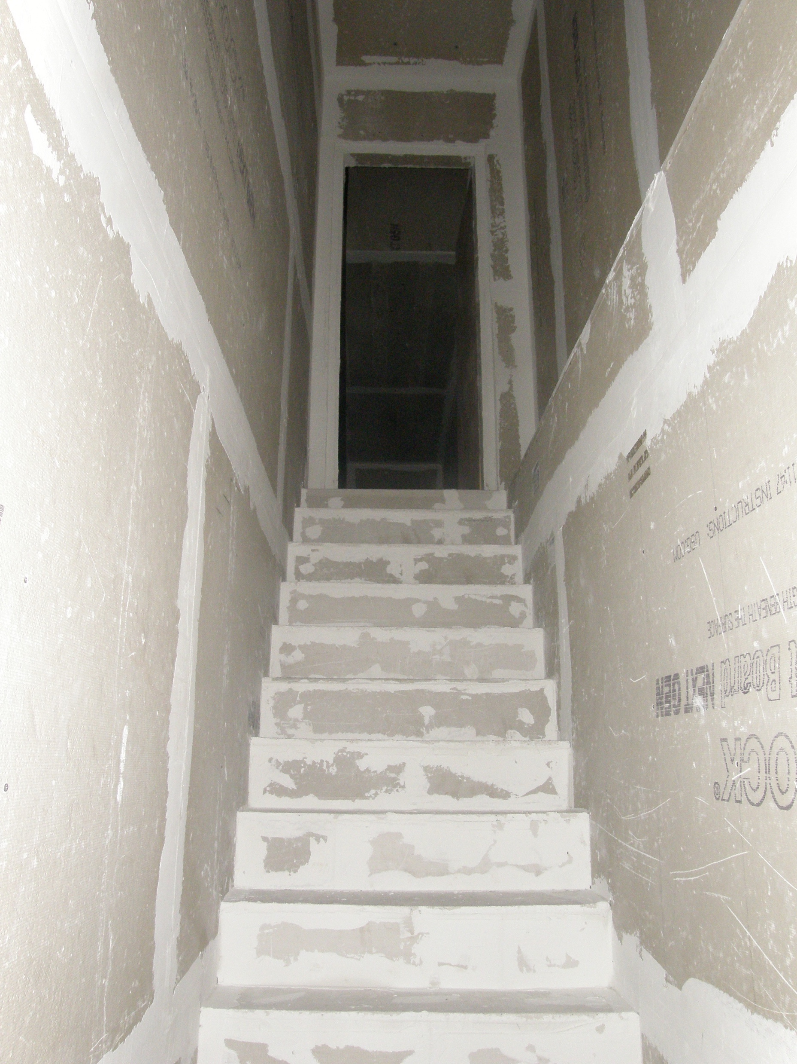
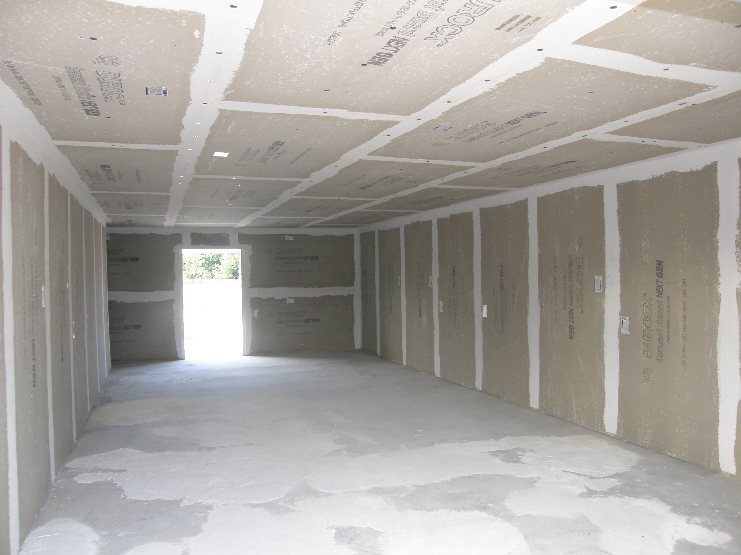
West Structure – 1st Floor
Notes:
39’ x 23’ => interior space ~ 35’x 16’
7.25” rise/7.5” run

Slide 12
West Structure – 2nd Floor
Notes:
0.8 m => 32” door
0.9 m => 36” door
Walls wood framed with 2x4s set to 16 in centers, two layers of 5/8” Type X gypsum board with a layer of ½” Durock cement board on top
Outer walls on 2nd floor had 7/16” OSB and 5/16” fiber cement lap siding

Slide 13
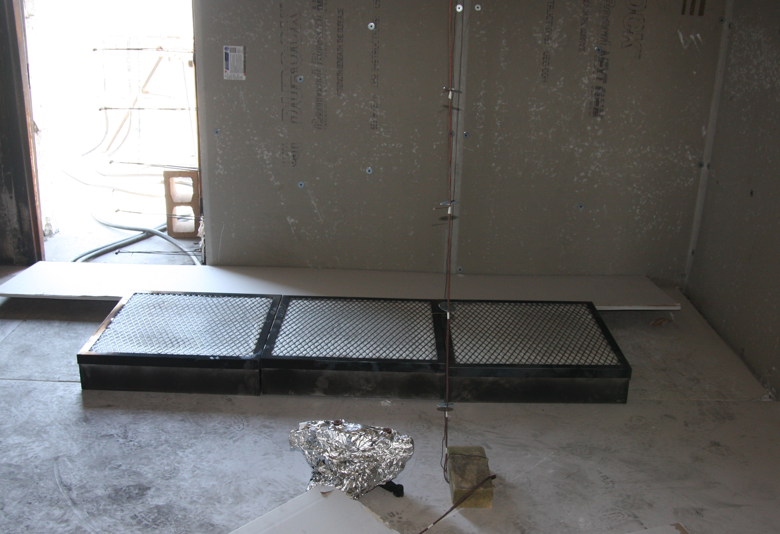
Fire Source
Three propane gas burners
Notes:
2’ x 2’ about 6” above the ground

Slide 14
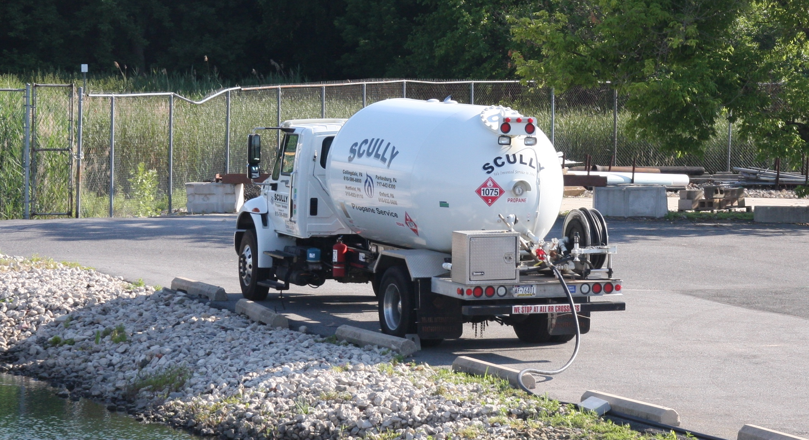
Fire Source
Provided by propane supply truck
Notes:
Propane supply for commercial industrial applications

Slide 15
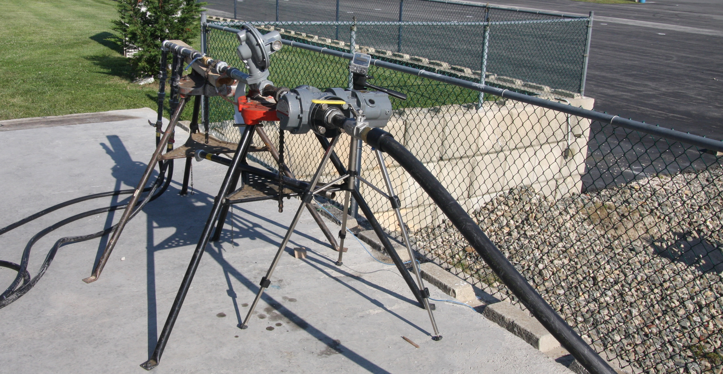
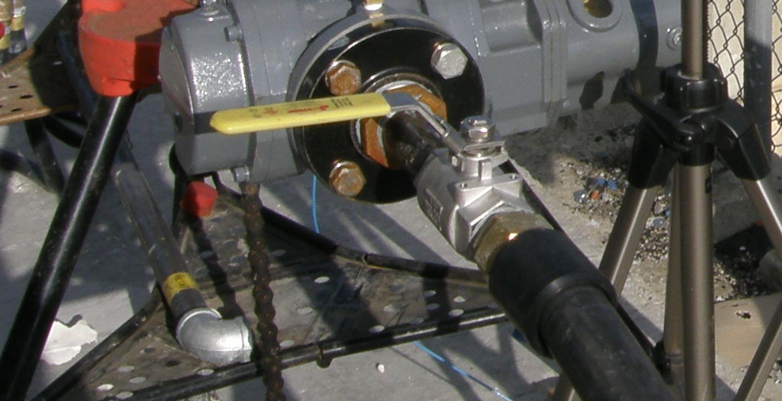
Fire Source
Flow controlled and measured at rotary gas meter
Total expanded uncertainty associated with HRR measurement^{[3]} – 8 %
Notes:
Zoom into each part of apparatus

Slide 16
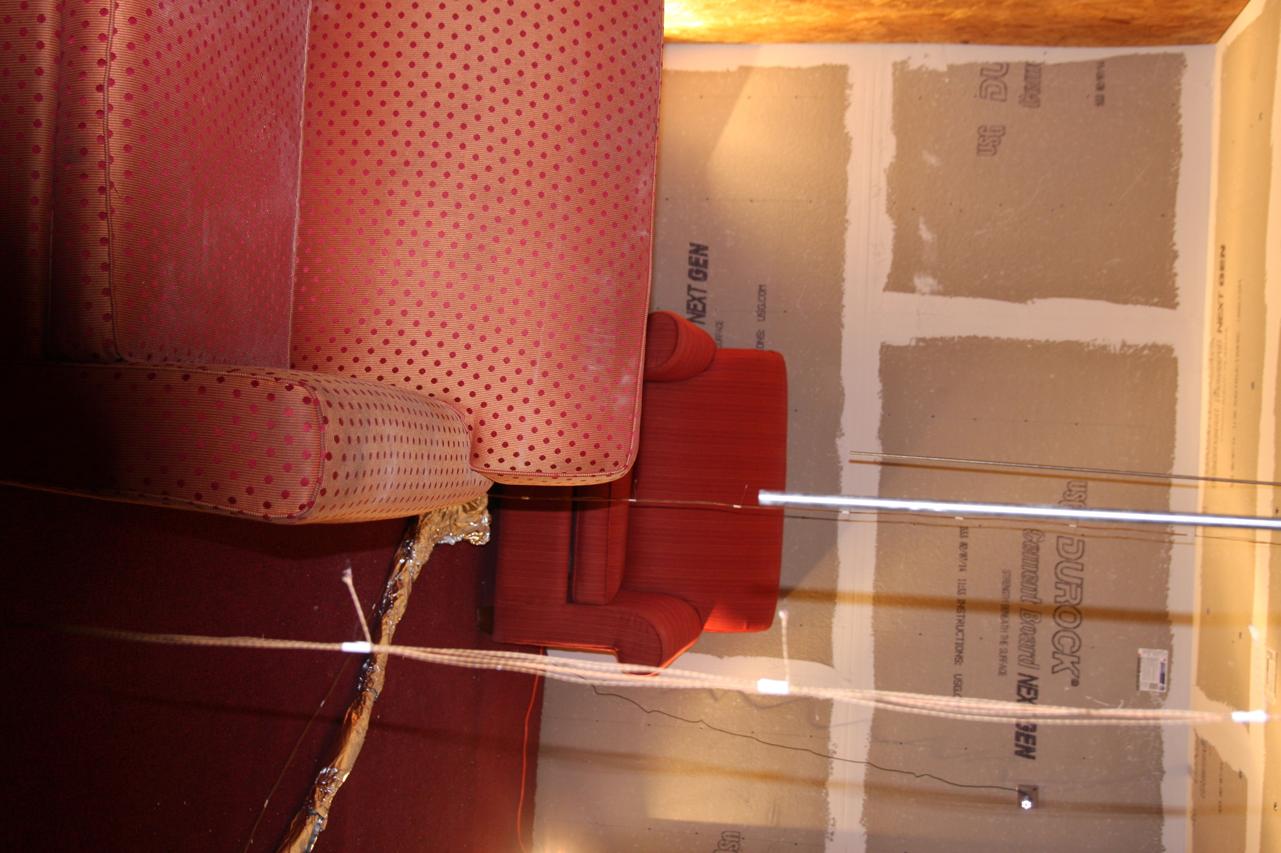
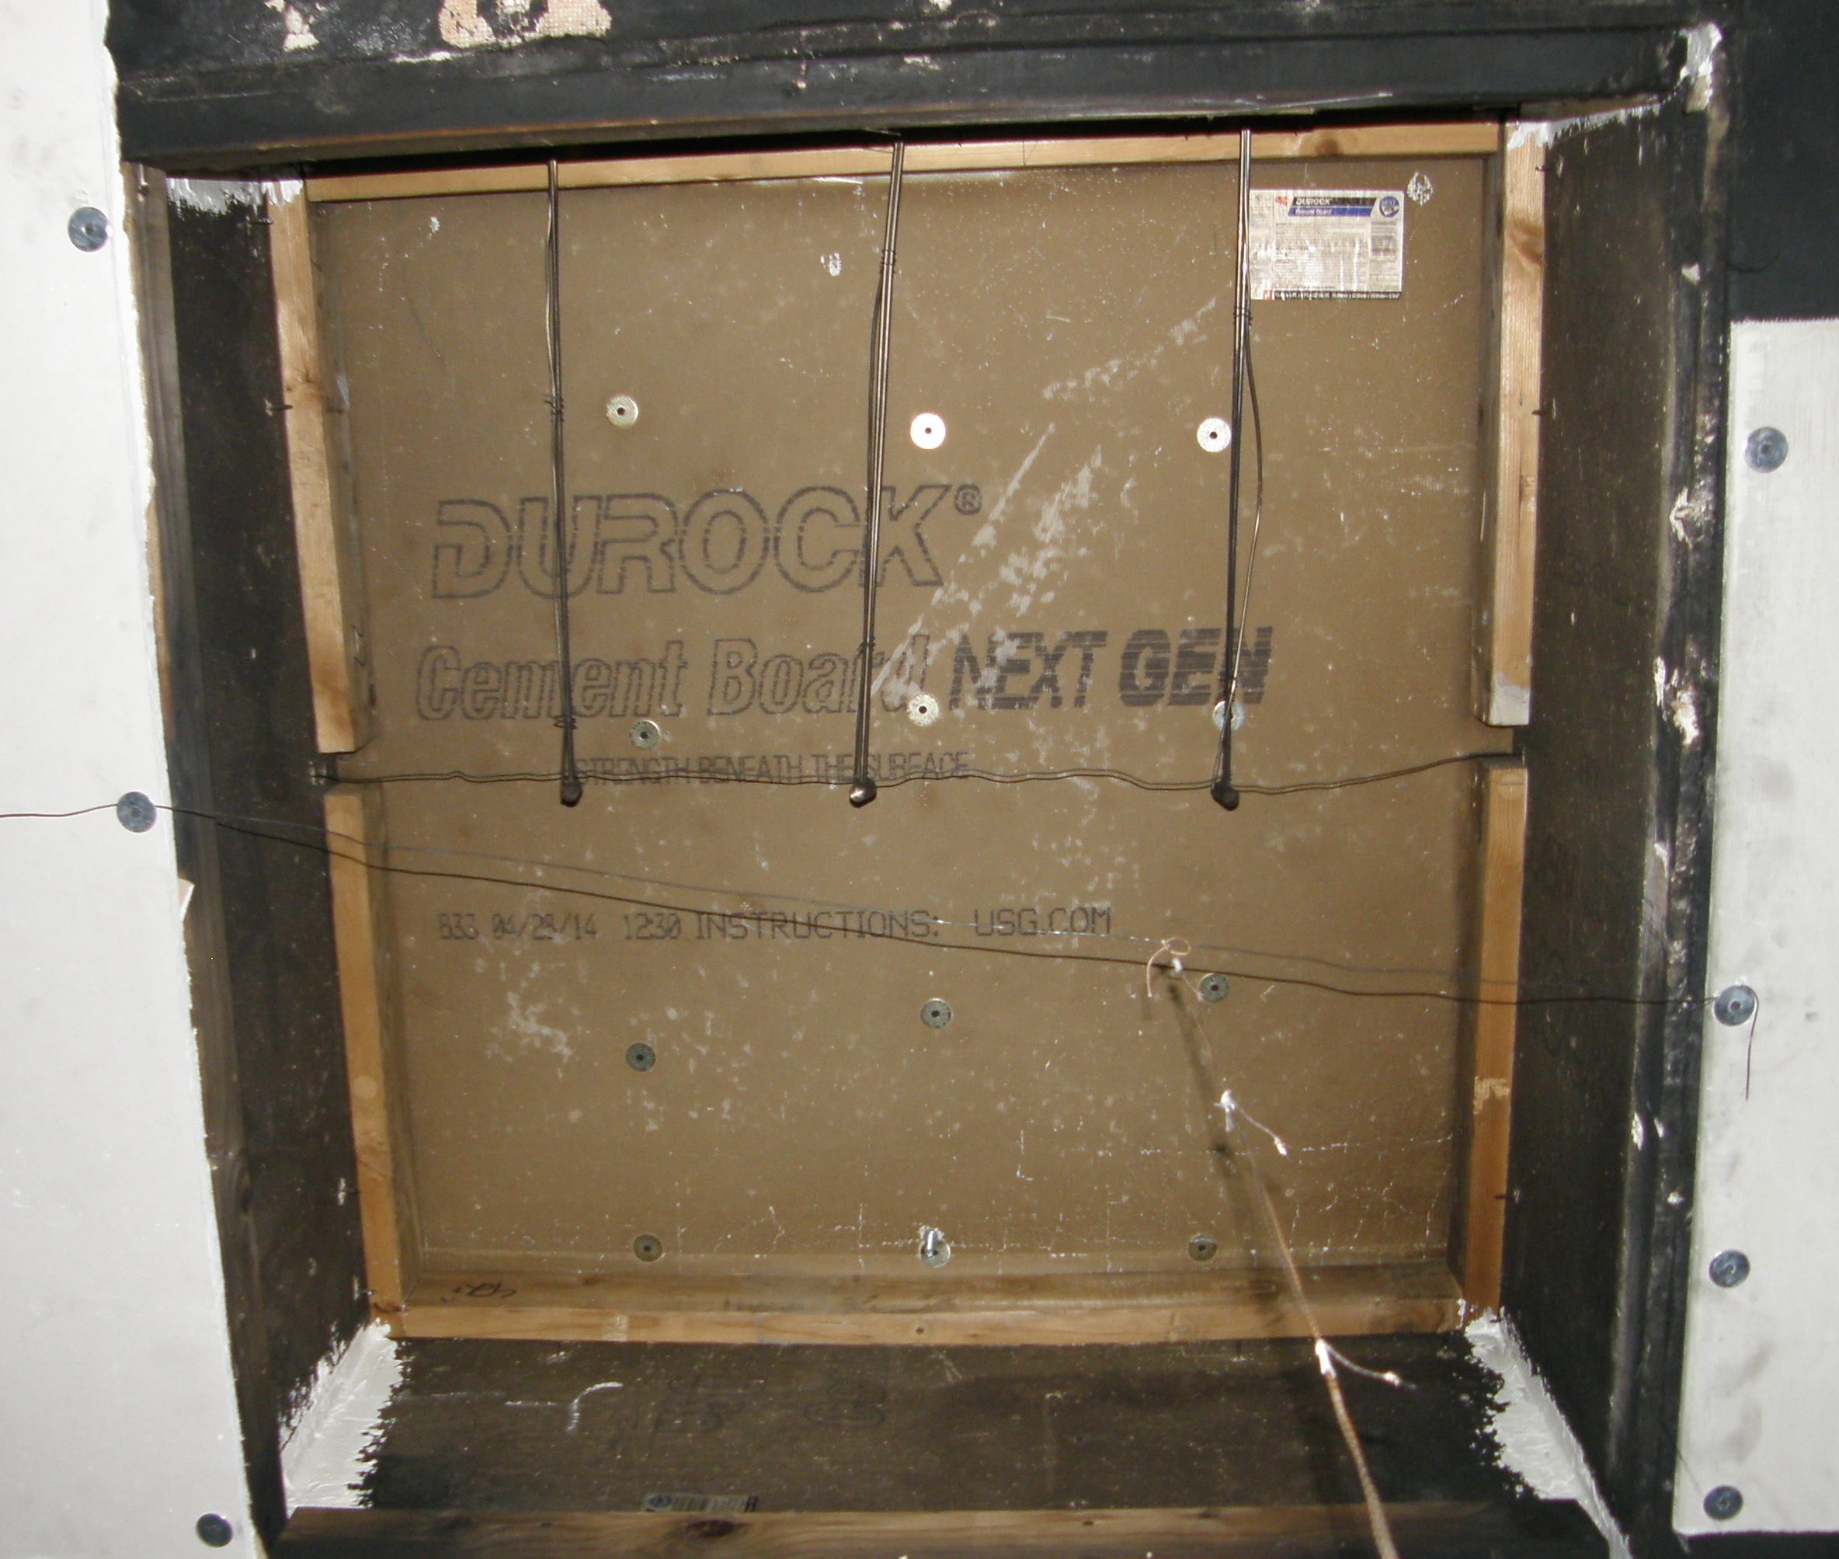
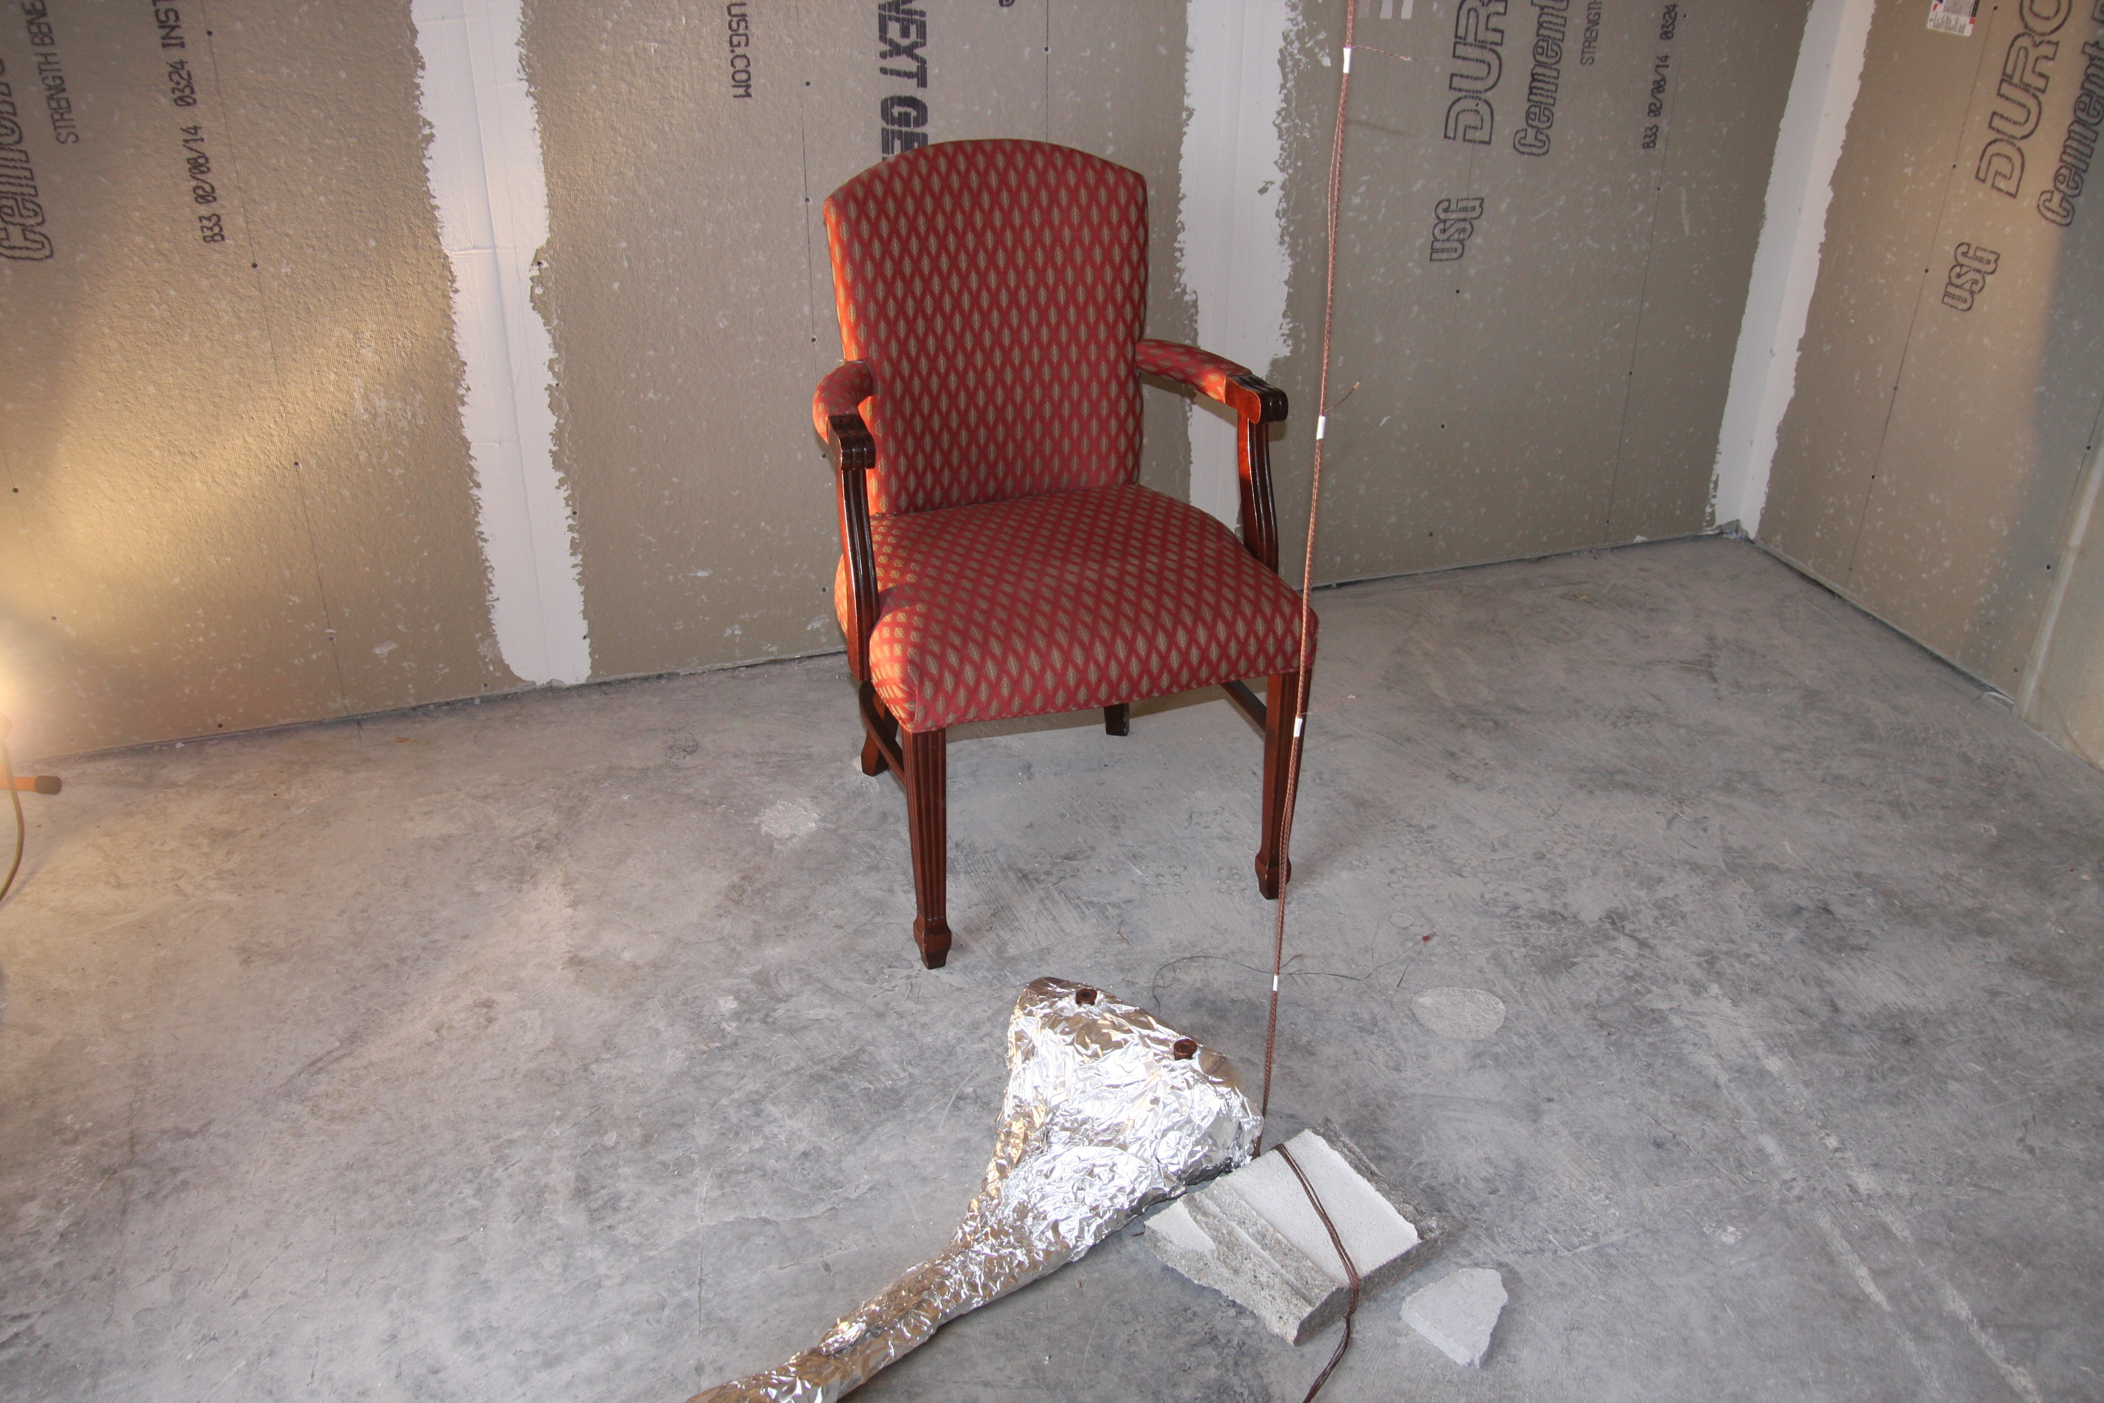
Instrumentation
Thermocouples
Gas sampling
Bi-directional probes (BDPs)
Heat flux gauges
Notes:
Floor plans with each type of instrumentation highlighted, uncertainty described

Slide 17
East Structure Instrumentation
Thermocouple arrays
Notes:
8 per array, 1 “ from ceiling, 12 “ apart after that

Slide 18
East Structure Instrumentation
Gas sampling locations
Notes:
4 ft above floor

Slide 19
East Structure Instrumentation
BDP array

Slide 20
East Structure Instrumentation
Heat flux gauges
Notes:
6” above floor looking at ceiling

Slide 21
West Structure Instrumentation
Thermocouple arrays – 1st Floor

Slide 22
West Structure Instrumentation
Gas sampling location – 1st Floor

Slide 23
West Structure Instrumentation
Thermocouple arrays – 2nd Floor

Slide 24
West Structure Instrumentation
Gas sampling location – 2nd Floor

Slide 25
West Structure Instrumentation
BDP array – 2nd Floor

Slide 26
West Structure Instrumentation
Heat flux gauges – 2nd Floor

Slide 27
Experimental Procedures

Slide 28
Overview of Experiments

Slide 29
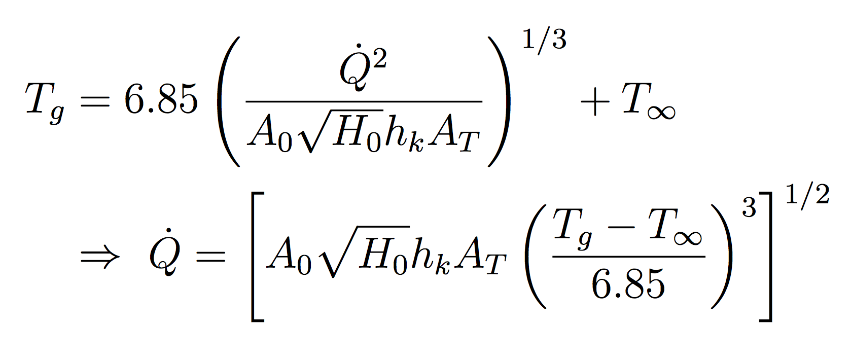
Tests 2-4 Heat Release Rate
Estimated via McCaffrey, Quintiere, and Harkleroad (MQH) correlation^{[9]}:
HGL temperatures estimated using thermocouple data
Notes:
-- h_k is the effective heat transfer coefficient; calculated by k/thickness
-- A_T is total area of compartment enclosing surfaces

Slide 30
Tests 2-4
Notes:
~ 3 minutes between burner ignitions
About 60 seconds til first door
2 minutes until 2nd double door
60 seconds until rear door

Slide 31
Tests 2-4
Notes:
~ 2 minutes between south door and first burner off
~ 2 minutes between next burners being extinguished
~ PPV after the test to help cool down structure

Slide 32
Overview of Experiments

Slide 33
Test 5

Slide 34
Test 5

Slide 35
Test 6

Slide 36
Overview of Experiments

Slide 37
Tests 22 & 23

Slide 38
Tests 24 & 25

Slide 39
FDS Simulation Description
Notes:
Pictures of smokeview structures

Slide 40
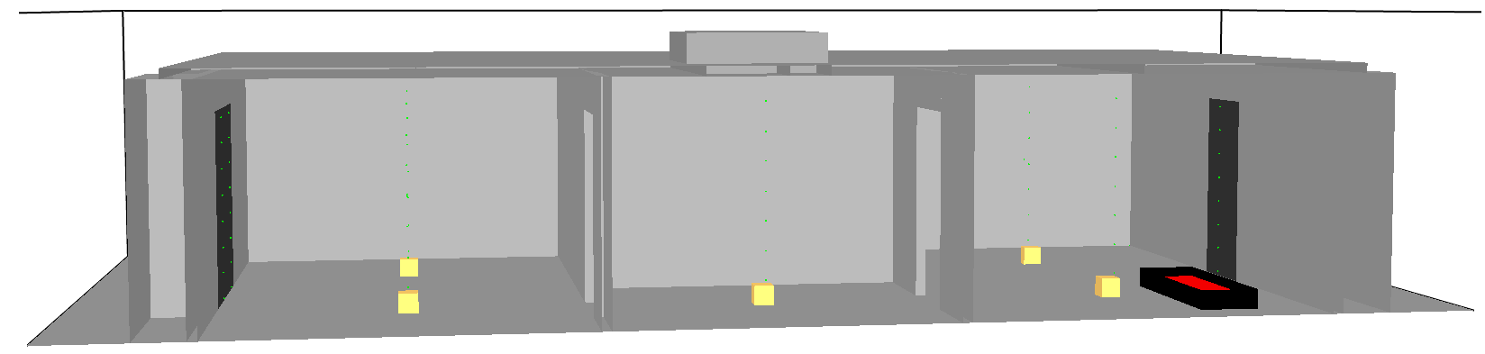
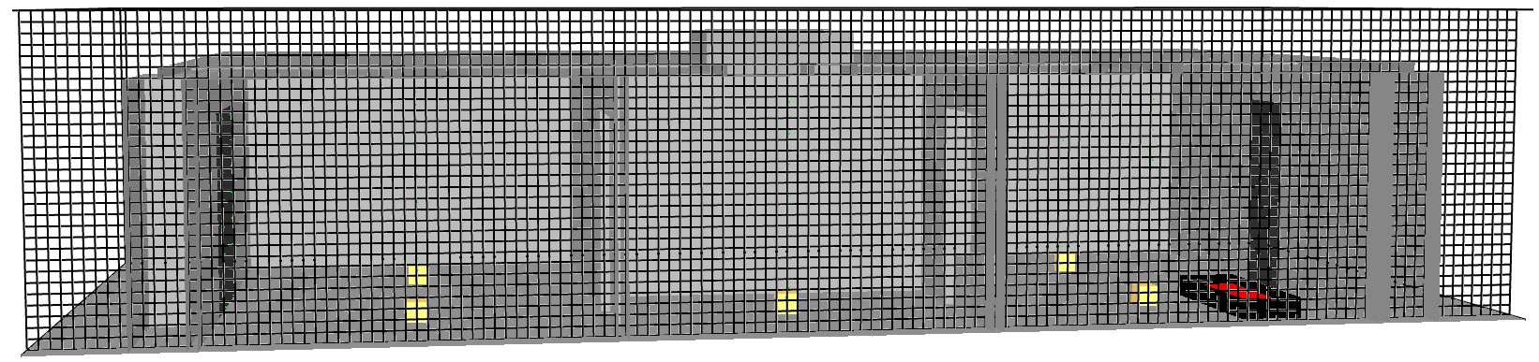
Computational Domain
Simulation domain divided into 3D rectangular computational cells
Gas density, velocity, temperature, pressure, species concentration calculated within each grid cell
Notes:
-- Using laws of mass, momentum, and energy conservation…

Slide 41
Computational Domain
User specifies grid cell size
Smaller cells → higher resolution
More cells → higher computational cost
How should grid cell size be selected?

Slide 42
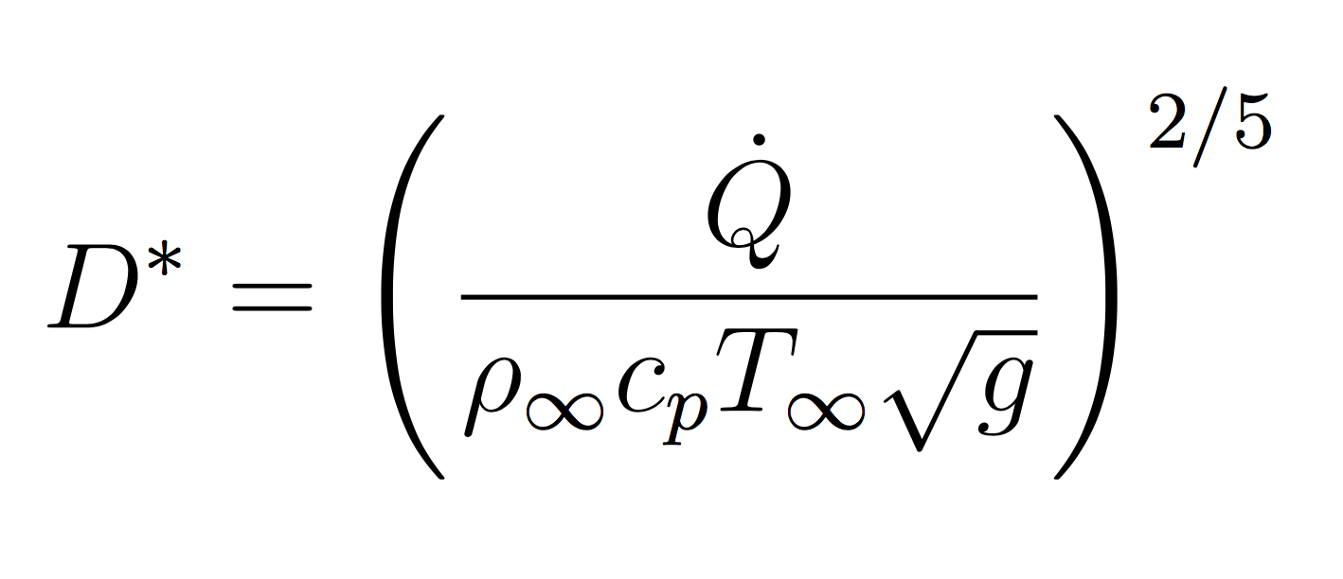
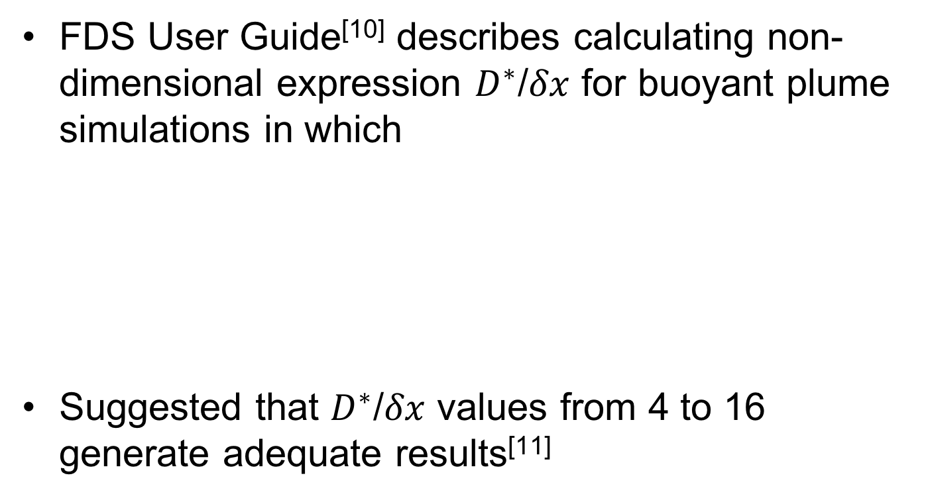
Grid Cell Size Selection
FDS User Guide^{[10]} describes calculating non-dimensional expression $D^{∗}$/$δx$ for buoyant plume simulations in which
Suggested that $D^{∗}$/$δx$ values from 4 to 16 generate adequate results^{[11]}
Notes:
-- cp specific heat of surrounding air
-- delta x nominal grid cell size

Slide 43
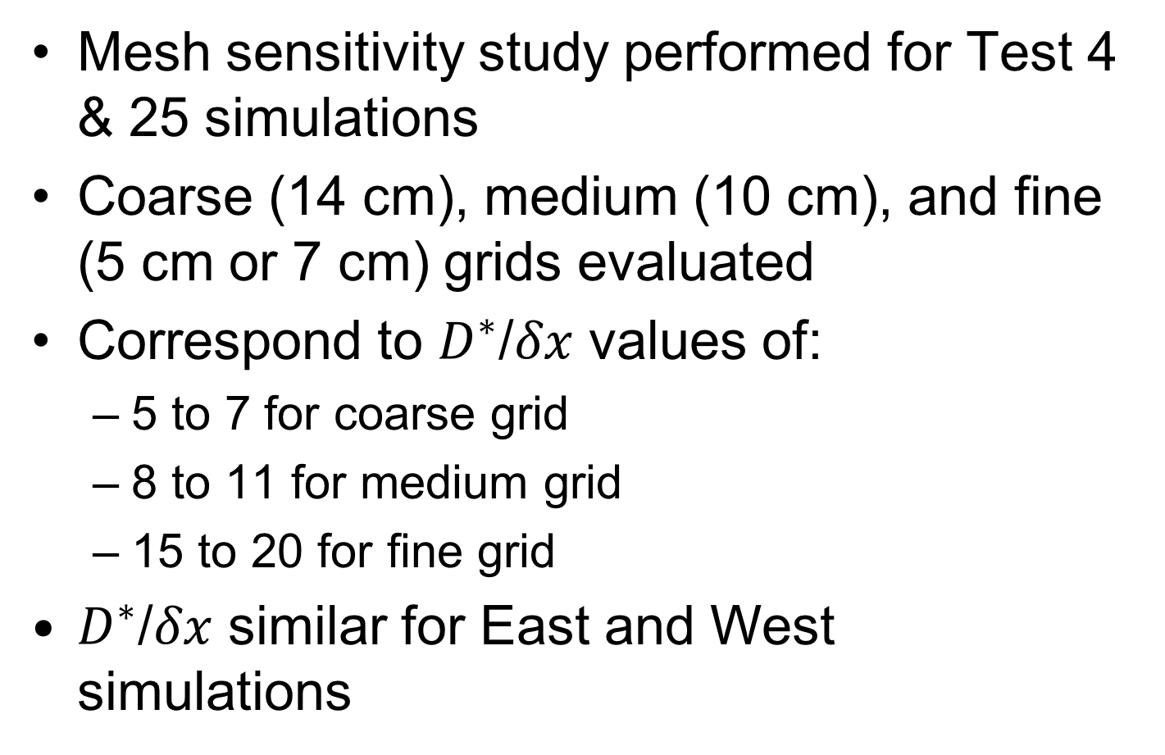
Grid Cell Size Selection
Mesh sensitivity study performed for Test 4 & 25 simulations
Coarse (14 cm), medium (10 cm), and fine (5 cm or 7 cm) grids evaluated
Correspond to $D^{∗}$/$δx$ values of:
5 to 7 for coarse grid
8 to 11 for medium grid
15 to 20 for fine grid
$D^{∗}$/$δx$ similar for East and West simulations
Notes:
-- Equally sized meshes per simulation to utilize MPI-parallell processing on multi-processor Linux machine

Slide 44
Mesh Sensitivity Analysis
East Structure – Ceiling Jet Temperature

Slide 45
Mesh Sensitivity Analysis
East Structure – Oxygen Concentration

Slide 46
Mesh Sensitivity Analysis
West Structure – Ceiling Jet Temperature

Slide 47
Mesh Sensitivity Analysis
West Structure – Oxygen Concentration

Slide 48
Grid Cell Size Selection
Run times:
Medium grid cell size selected (10 cm)
East Structure: 336,000 computational cells
West Structure: 604,800 computational cells
Cells divided into eight equally sized meshes
Notes:
-- Smokeview pictures; grid
-- Equally sized meshes per simulation to utilize MPI-parallell processing on multi-processor Linux machine

Slide 49
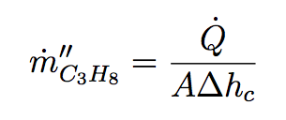
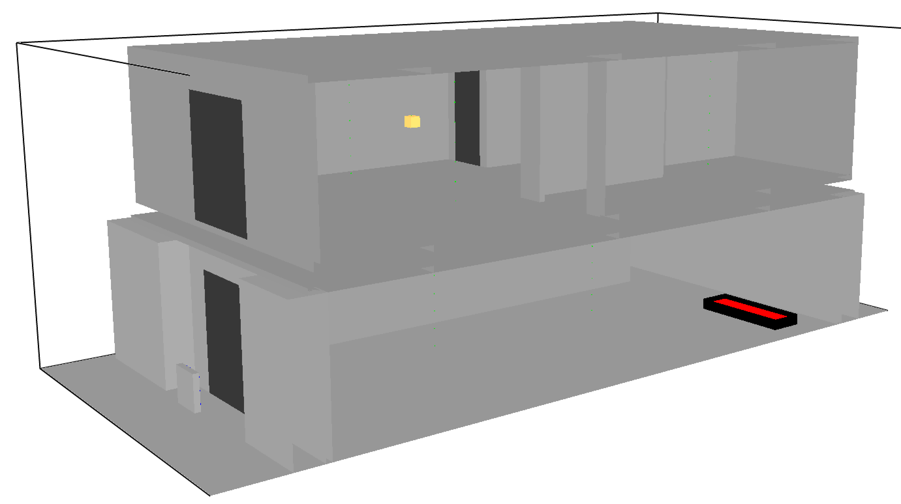
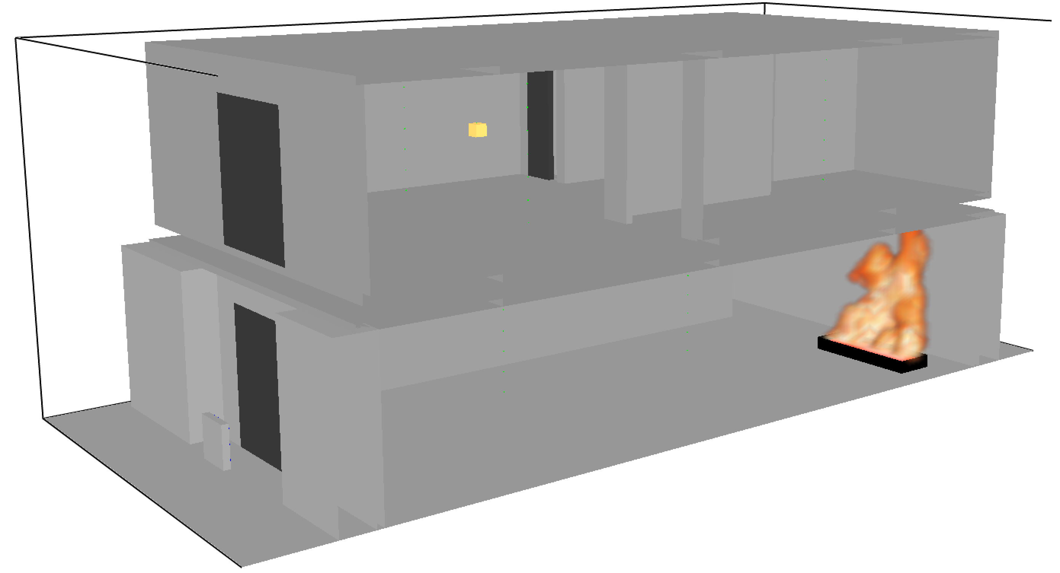
Source Fire Characterization
Steel sides, top surface specified mass flux of propane based on
Notes:
-- Reaction mechanisms for combustion in all simulations default mixing controlled, simple chemistry model
-- Smokeview picture of burners
-- Value of Delta h_c

Slide 50
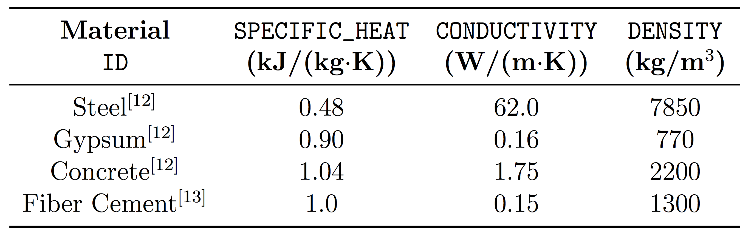
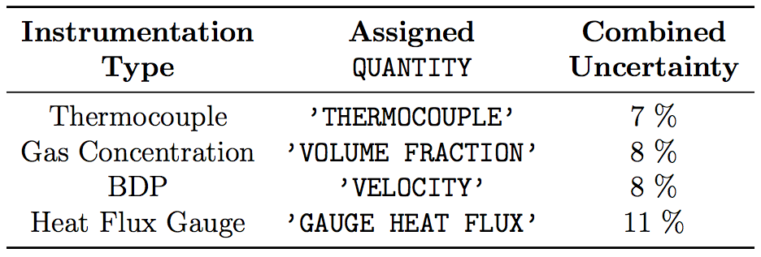
Other Defined Parameters
Four materials explicitly defined
Instrumentation defined using FDS devices
Notes:
-- Add correct refs to table

Slide 51
Results and Discussion

Slide 52
Types of Data Plots
Two types of plots presented for each data quantity
Experimental and FDS simulation data plots
Summary log/log scatter plots similar to those presented in FDS Validation Guide
Intended to summarize uncertainty of model in predicting given measurement^{[14]}
Notes:
Hot gas layer T, ceiling jet T, individual TCs in TC arrays, CO2 and O2 concentrations, Gas velocity, total heat flux

Slide 53
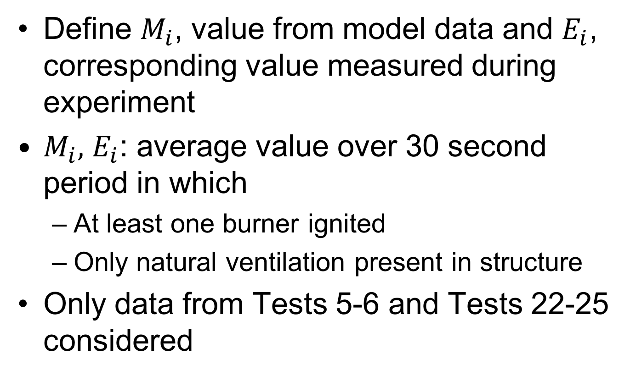
Summary Plots
Define $M_{i}$, value from model data and $E_{i}$, corresponding value measured during experiment
$M_{i},$ $E_{i}$: average value over 30 second period in which
At least one burner ignited
Only natural ventilation present in structure
Only data from Tests 5-6 and Tests 22-25 considered
Notes:
-- assume ln(M/E) is normally distributed

Slide 54
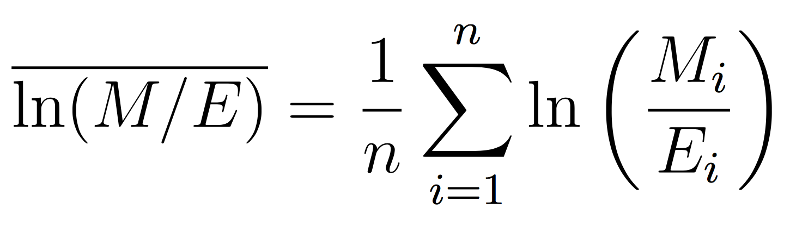
Summary Plots
Calculate mean and standard deviation of distribution by first calculating
Assume is normally distributed
(Note: assumption tested and results shown in
FDS Validation Guide)
Notes:
-- assume ln(M/E) is normally distributed

Slide 55
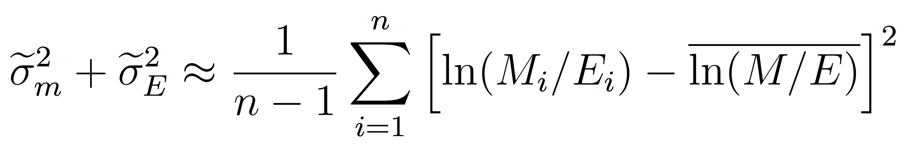
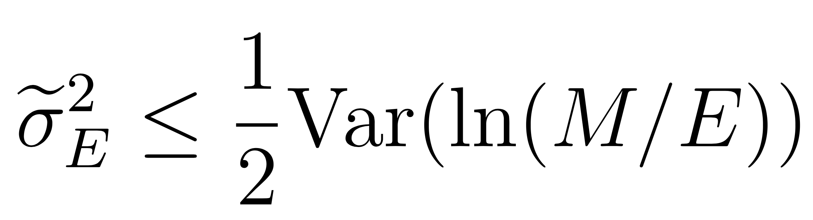
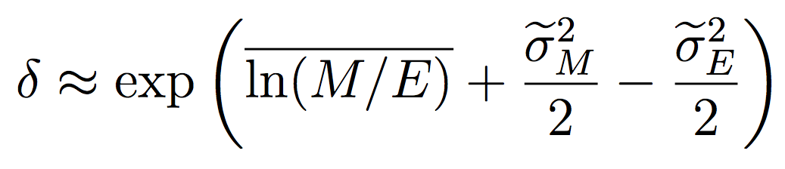
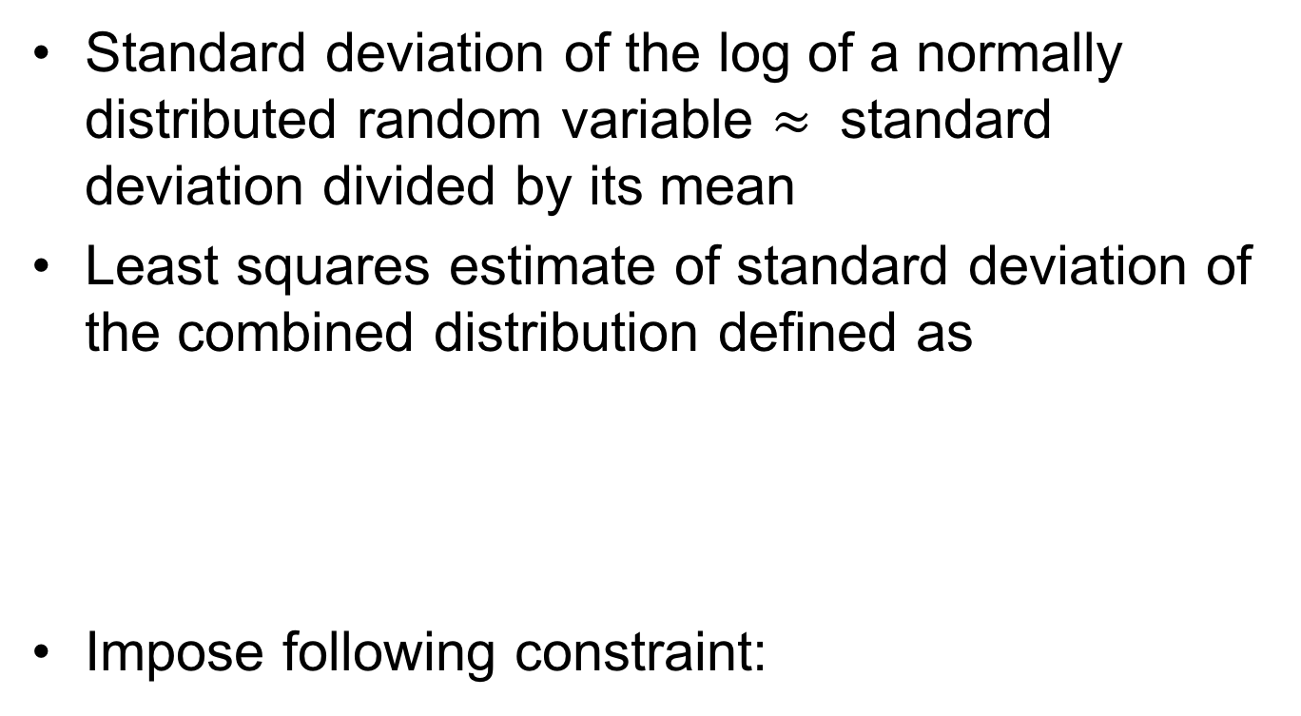
Summary Plots
Standard deviation of the log of a normally distributed random variable $≈$ standard deviation divided by its mean
Least squares estimate of standard deviation of the combined distribution defined as
Impose following constraint:
Notes:
-- assume ln(M/E) is normally distributed
-- know sigma e

Slide 56
Summary Plots
The following is produced
And using the mean of the distribution, a bias factor can be estimated as
Notes:
-- Example from FDS Validation Guide?
-- describe gray points; solid lines expected values, dashed lines +/-, etc.

Slide 57
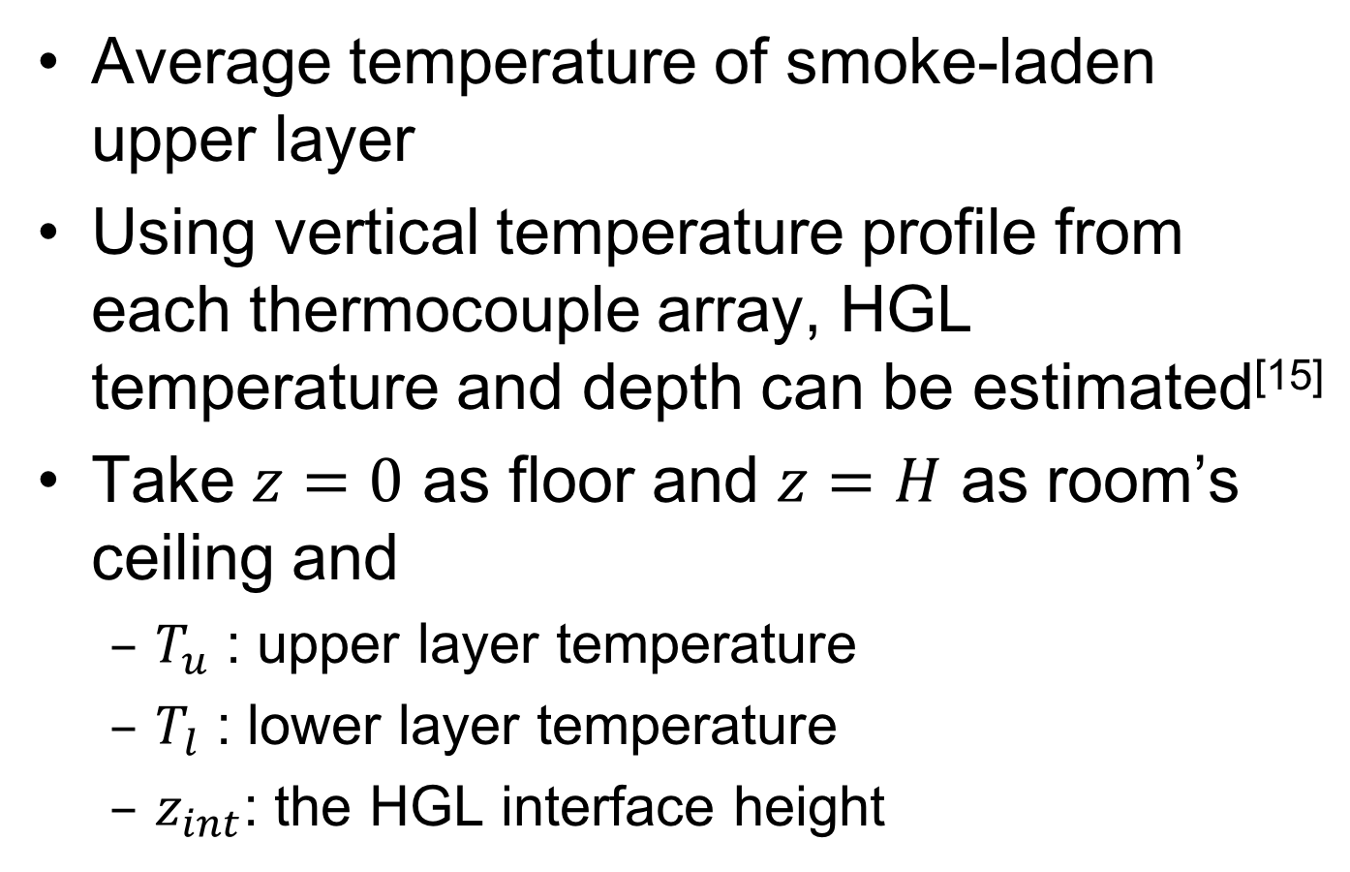
HGL Temperature Estimation
Average temperature of smoke-laden upper layer
Using vertical temperature profile from each thermocouple array, HGL temperature and depth can be estimated^{[15]}
Take $z=0$ as floor and $z=H$ as room’s ceiling and
$T_{u}$ : upper layer temperature
$T_{l}$ : lower layer temperature
$z_{int}$: the HGL interface height
Notes:
-- Picture of HGL

Slide 58
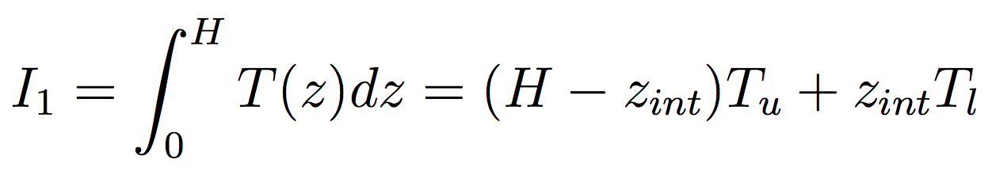
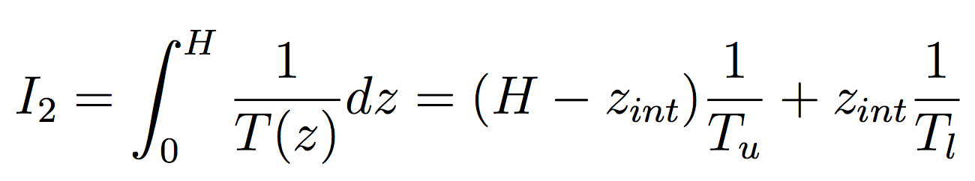
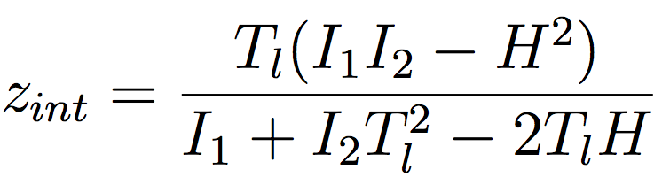
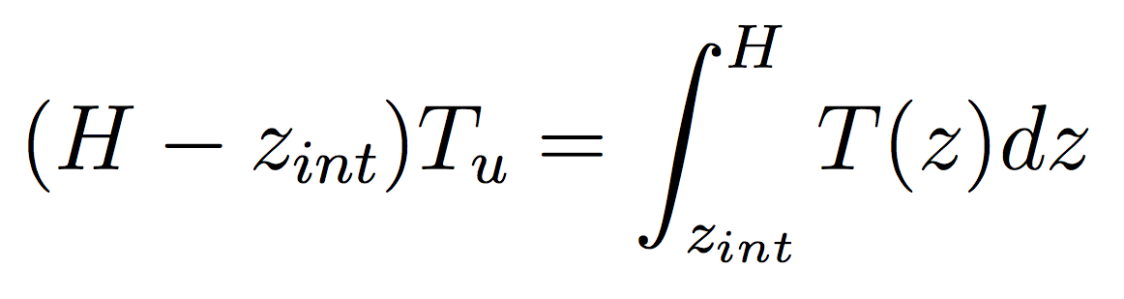
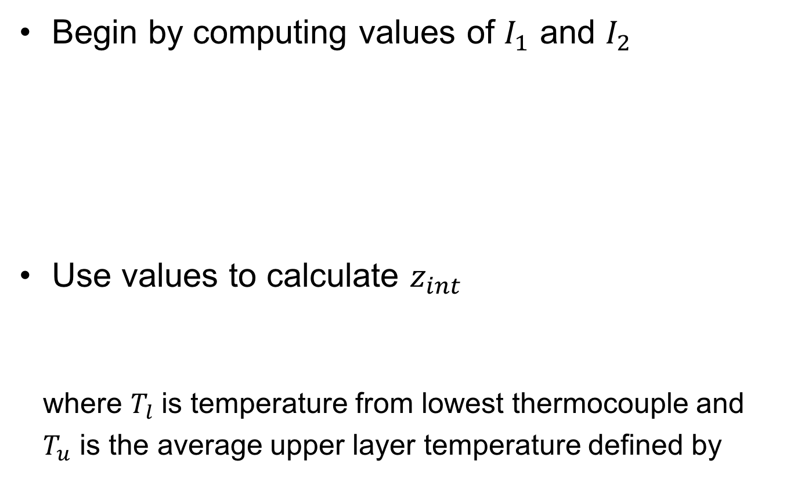
HGL Temperature Estimation
Begin by computing values of $I_{1}$ and $I_{2}$
Use values to calculate $z_{int}$
where $T_{l}$ is temperature from lowest thermocouple and
$T_{u}$ is the average upper layer temperature defined by

Slide 59
HGL Data Plot – Test 22

Slide 60
HGL Summary Plot

Slide 61
Ceiling Jet Temperature
Temperature near ceiling
Useful to predict alarm, sprinkler, smoke detector activation times
Taken as top thermocouple temperature
Notes:
Hot gas layer T, ceiling jet T, individual TCs in TC arrays, CO2 and O2 concentrations, Gas velocity, total heat flux

Slide 62
Ceiling Jet Data Plot – Test 4

Slide 63
Ceiling Jet Summary Plot

Slide 64
TC Array Data Plot – Test 4

Slide 65
TC Array Summary Plot

Slide 66
O₂ Concentration Data Plot – Test 24

Slide 67
O₂ Concentration Summary Plot

Slide 68
CO₂ Concentration Data Plot – Test 6

Slide 69
CO₂ Concentration Summary Plot

Slide 70
Gas Velocity Data Plot – Test 6

Slide 71
Gas Velocity Summary Plot

Slide 72
Heat Flux Data Plot – Test 3

Slide 73
Heat Flux Summary Plot

Slide 74
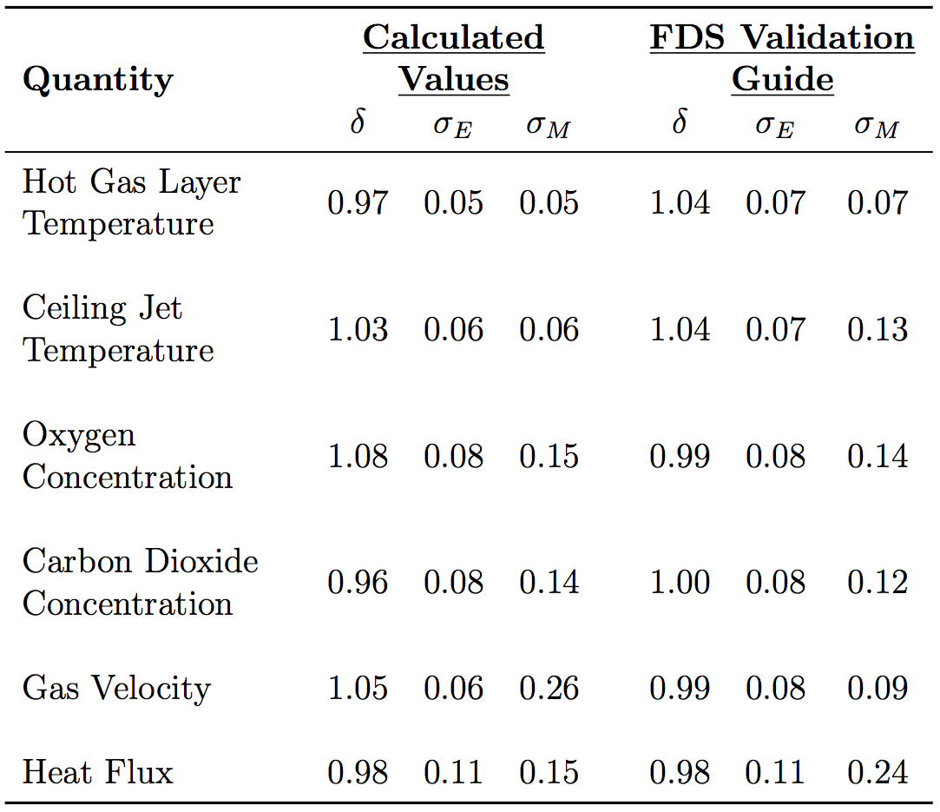
Summary of Results

Slide 75
Summary of Results
Agreement between experimental data and FDS model data
HGL, ceiling jet, and heat flux better than expected
Gas species model bias worse than value from FDS Validation Guide; relative model standard deviation 0.01 or 0.02 worse
Gas velocity contains largest discrepancy

Slide 76
Summary of Results
Discrepancy in gas velocity values could be a result of
Conducted outdoors
BDPs had the highest exp uncertainty
LES CFD models limited when it comes to turbulent gas flow at fine resolutions

Slide 77
Conclusion
Propane gas burner tests conducted amongst two residential-sized structures
Experiments modeled using FDS
Results compared to measured data
Sufficient agreement with largest discrepancy gas velocity
Results add an important data set to FDS validation guide

Slide 78
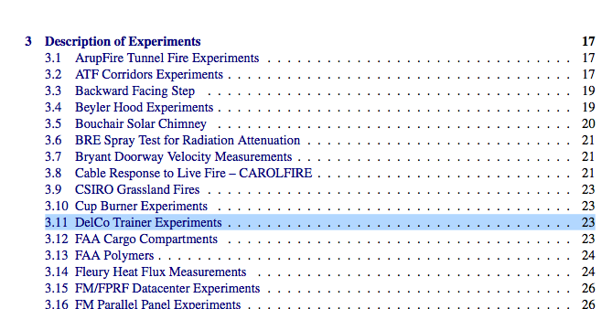
Conclusion
Set of experiments added in most recent version of FDS Validation Guide

Slide 79
Acknowledgements
NIST and specifically the following individuals
Dan Madrzykowski
Kristopher Overholt
Roy McLane
Keith Stakes
Craig Weinschenk
Delaware County Emergency Services Training Center, namely Deputy Director Kerby Kerber
Dr. Kevin McGrattan of NIST
Dr. James Milke
Dr. Arnaud Trouvé & Dr. Craig Weinschenk
Notes:
And of course the audience!

Slide 80
Questions?

Slide 81
Thermocouples
Bare-bead, type K from OMEGA Engineering Inc.
Eight thermocouples per array, spaced 12” apart with top 1” below ceiling
Total expanded uncertainty^{[4,5]} – 15 %

Slide 82
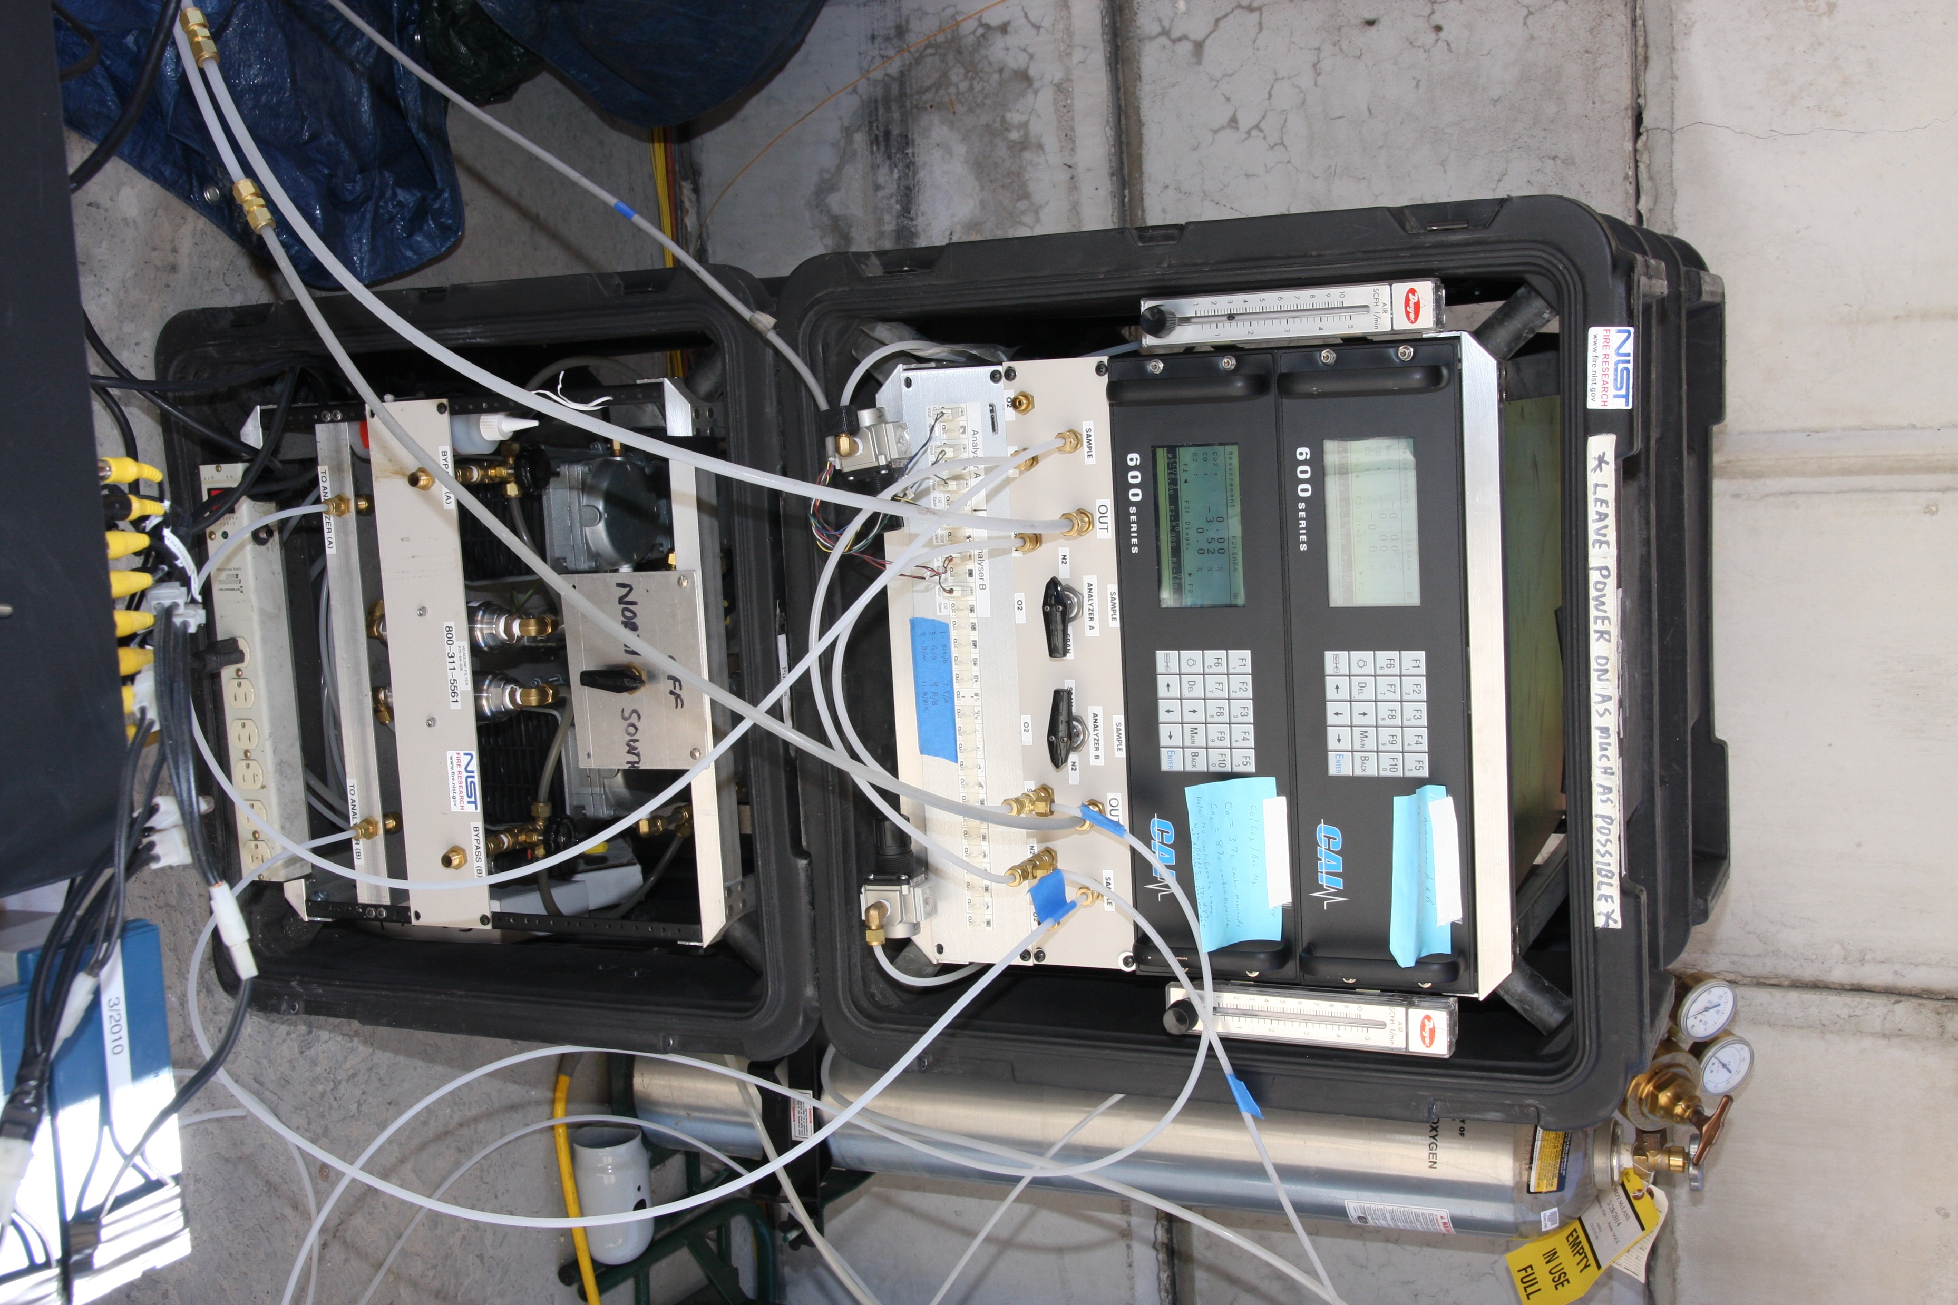
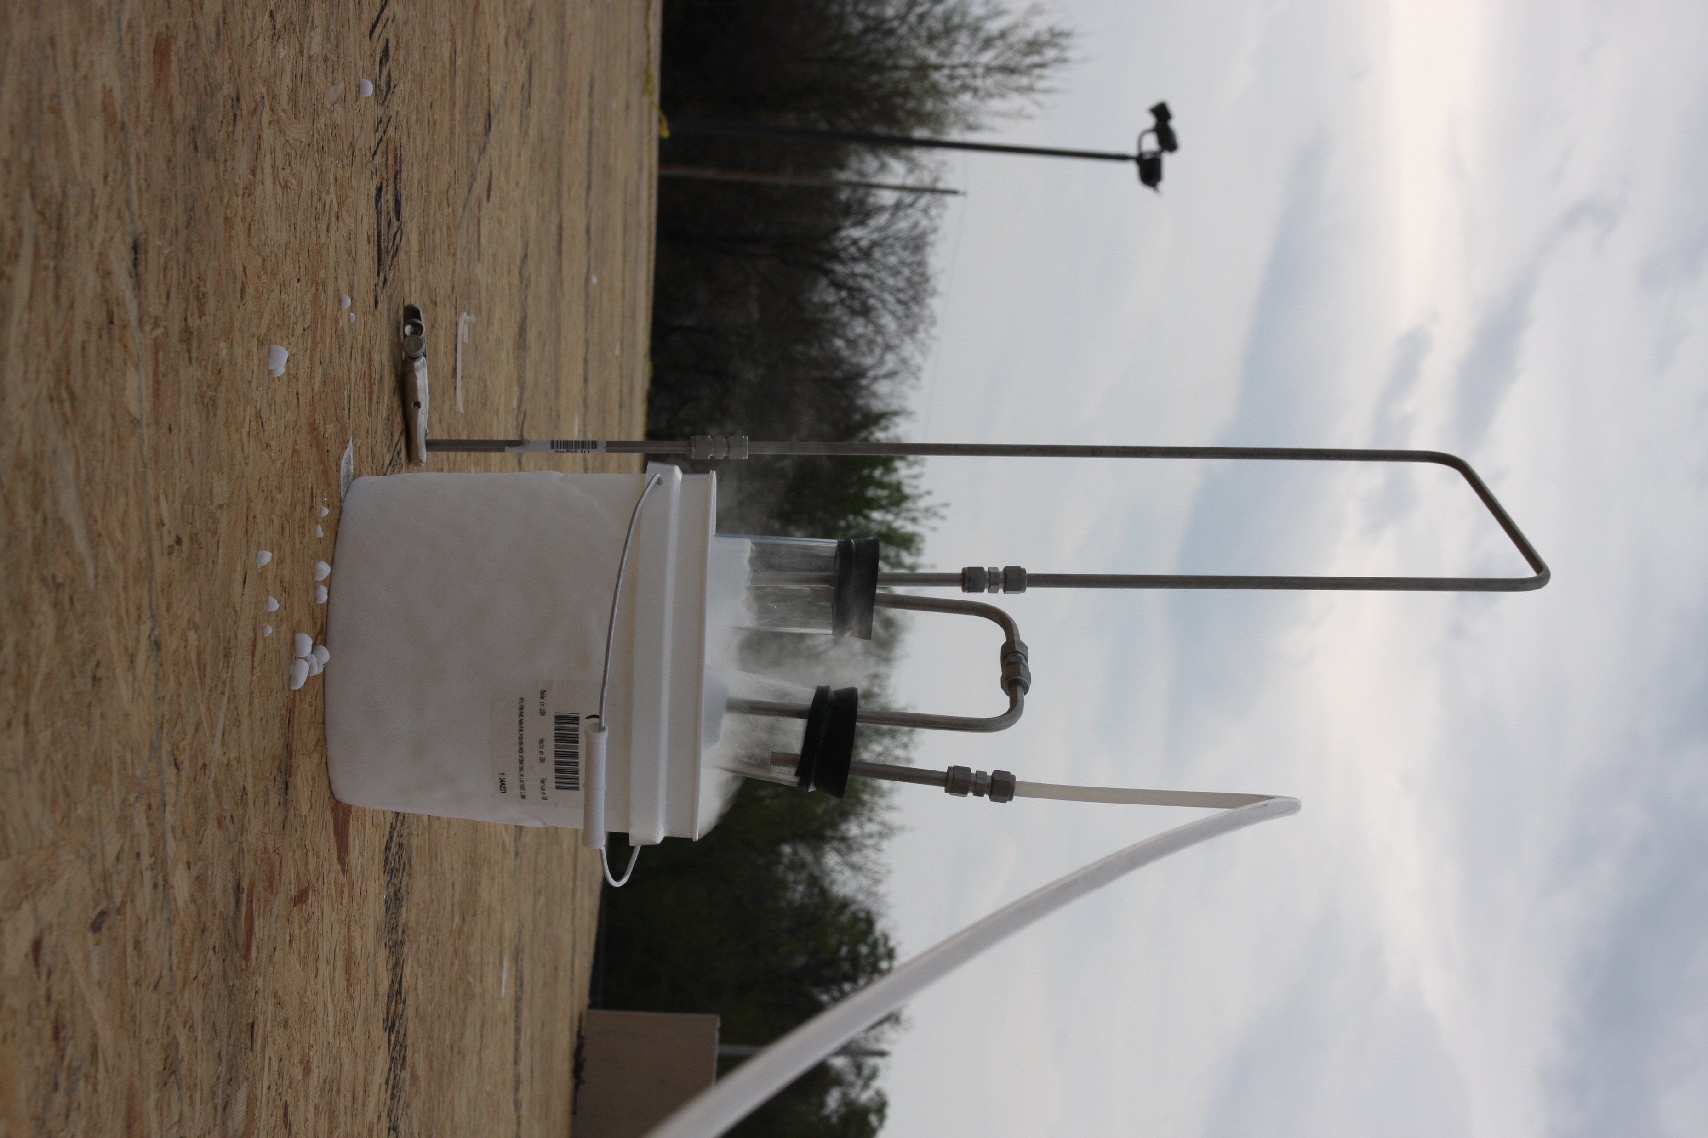
Gas Sampling
System from California Analytical Instruments, Inc.
Pulled through 3/8” stainless steel tubing located 4’ above floor and through filter in dry ice to cool sample
Total expanded uncertainty^{[6]} – 12 %

Slide 83
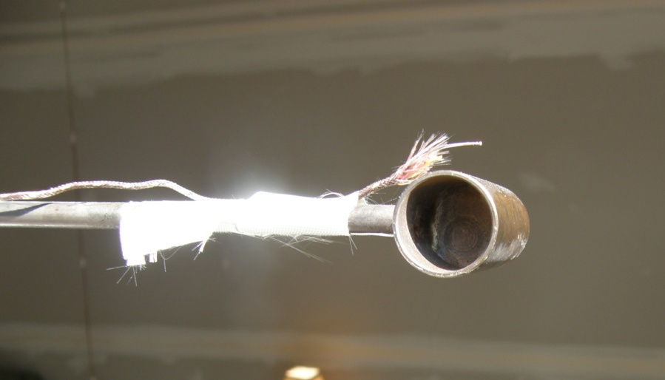
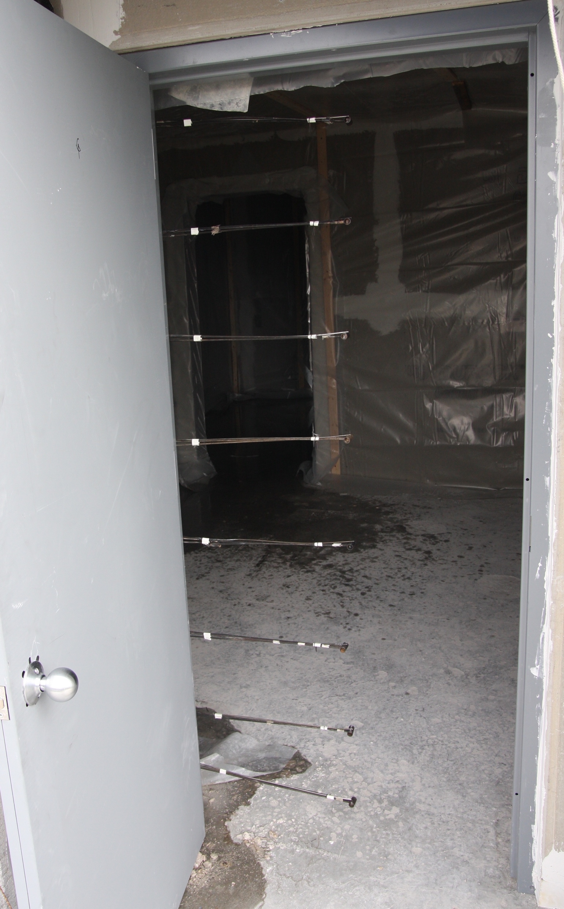
Bi-Directional Probes
Each probe with Setra 264 pressure transducer and bare-bead, type K thermocouple
East Structure: three probes centered in roof vent
West Structure: eight probes centered in doorway
Total expanded uncertainty^{[7]} – 14 % to 22 % (18 % used for analysis)
Notes:
Each probe in doorway centered and spaced 10” apart with top one 3” below soffit

Slide 84
Total Heat Flux
Water-cooled, Schmidt- Boelter total heat flux gauges
East Structure: single gauge 6” above floor, facing ceiling
West Structure: pair of gauges 3’ 3” above floor, one facing ceiling, one facing wall
Total expanded uncertainty^{[8]} – 8 %

Slide 85
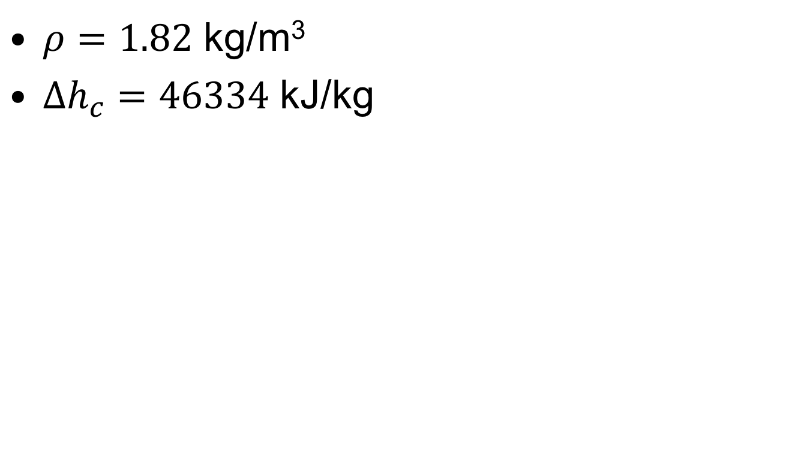
Propane Properties
$ρ=1.82$ kg/m³
$Δh_{c}=46334$ kJ/kg
R.C. Reid, J.M. Prausnitz, and B.E. Poling. Properties of Gases and Liquids. McGraw-Hill, New York, 4th edition, 1987.

Slide 86
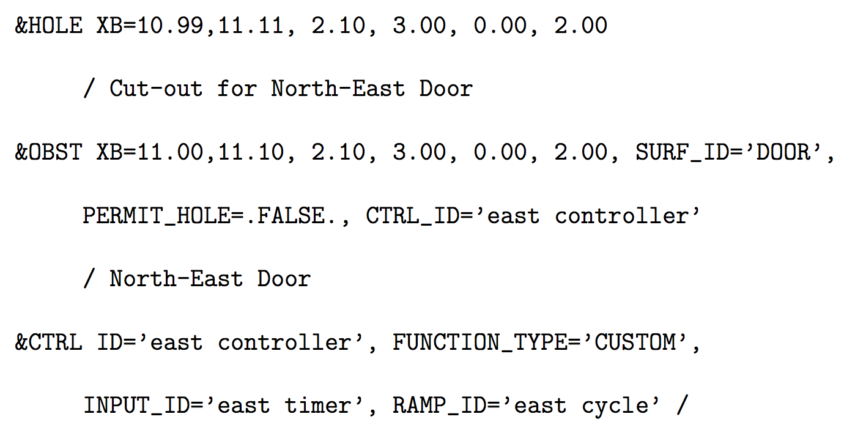
FDS Vent Example

Slide 87
Leakage Measurements
East Structure – 0.024 m²
West Structure
Stairway door closed – 0.027 m²
Stairway door opened – 0.054 m²
Stairway in ”closed” position – 0.048 m²

Slide 88
Source Fire Combustion
Two-step, fast reaction mechanism with gas phase suppression set to FALSE
Best way to handle set of reactions, extinction model for multiple fast reactions not very robust
Notes:
-- Reaction mechanisms for combustion in all simulations default mixing controlled, simple chemistry model
-- Smokeview picture of burners
-- Value of Delta h_c

Slide 89
References
[1] K. McGrattan, S. Hostikka, R. McDermott, J. Floyd, C. Weinschenk, and K.
Overholt. Fire Dynamics Simulator, Technical Reference Guide, Volume 2:
Verification. National Institute of Standards and Technology, Gaithersburg,
Maryland, USA, and VTT Technical Research Centre of Finland, Espoo,
Finland, sixth edition, September 2013.
[2] K. McGrattan, S. Hostikka, R. McDermott, J. Floyd, C. Weinschenk, and K.
Overholt. Fire Dynamics Simulator, Technical Reference Guide, Volume 3:
Validation. National Institute of Standards and Technology, Gaithersburg,
Maryland, USA, and VTT Technical Research Centre of Finland, Espoo,
Finland, sixth edition, September 2013.
[3] Romet Limited, East Mississauga, Ontario. Rotary Gas Meter RM3000
Technical Specification, 2014.
[4] L.G. Blevins. Behavior of bare and aspirated thermocouples in compartment
fires. In National Heat Transfer Conference, 33rd Proceedings, pages 15–17,
1999.
[5] W.M. Pitts, E. Braun, R. Peacock, H. Mitler, E. Johnson, P. Reneke, and
L.G. Blevins. Temperature uncertainties for bare-bead and aspirated
thermocouple measurements in fire environments. ASTM Special Technical
Publication, 1427:3–15, 2003.

Slide 90
References
[6] A. Lock, M. Bundy, E.L. Johnsson, A. Hamins, G.H. Ko, C. Hwang, P.
Fuss, and R. Harris. Experimental study of the effects of fuel type, fuel
distribution, and vent size on full-scale underventilated compartment fires
in an ISO 9705 room. NISTTN 1603, National Institute of Standards and
Technology, Gaithersburg, MD, 2008.
[7] R.A. Bryant. A comparison of gas velocity measurements in a full-scale
enclosure fire. Fire Safety Journal, 44:793–800, 2009.
[8] W.M. Pitts, A.V. Murthy, J.L. de Ris, J. Filtz, K. Nygard, D. Smith, and I.
Wetterlund. Round robin study of total heat flux gauge calibration at fire
laboratories. Fire Safety Journal, 41(6):459–475, 2006.
[9] B. McCaffery, J. Quintiere, and M. Harkleroad. Estimating Room Fire
Temperatures and the Likelihood of Flashover Using Fire Test Data
Correlations. Fire Technology, 17(2):98–119, 1981.
[10] K. McGrattan, S. Hostikka, R. McDermott, J. Floyd, C. Weinschenk, and
K. Overholt. Fire Dynamics Simulator, User’s Guide. National Institute of
Standards and Technology, Gaithersburg, Maryland, USA, and VTT
Technical Research Centre of Finland, Espoo, Finland, sixth edition,
September 2013.

Slide 91
References
[11] K. Hill, J. Dreisbach, F. Joglar, B. Najafi, K. McGrattan, R. Peacock, and A.
Hamins. Verification and Validation of Selected Fire Models for Nuclear
Power Plant Applications. NUREG-1824, United States Nuclear Regulatory
Commission, Washington, DC, 2007.
[12] D. Gross. Data Sources for Parameters Used in Predictive Modeling of Fire
Growth and Smoke Spread. NBSIR 85-3223, National Bureau of
Standards (now NIST), Gaithersburg, Maryland, September 1988.
[13] USG Corporation, Chicago, IL. USG DUROCK Brand Cement Board
Submittal Sheet CB399, 2016.
[14] K. McGrattan and B. Toman. Quantifying the predictive uncertainty of
complex numerical models. Metrologia, 48:173–180, 2011.
[15] M.L. Janssens and H.C. Tran. Data Reduction of Room Tests for Zone
Model Validation. Journal of Fire Science, 10:528–555, 1992.

